Slide 1
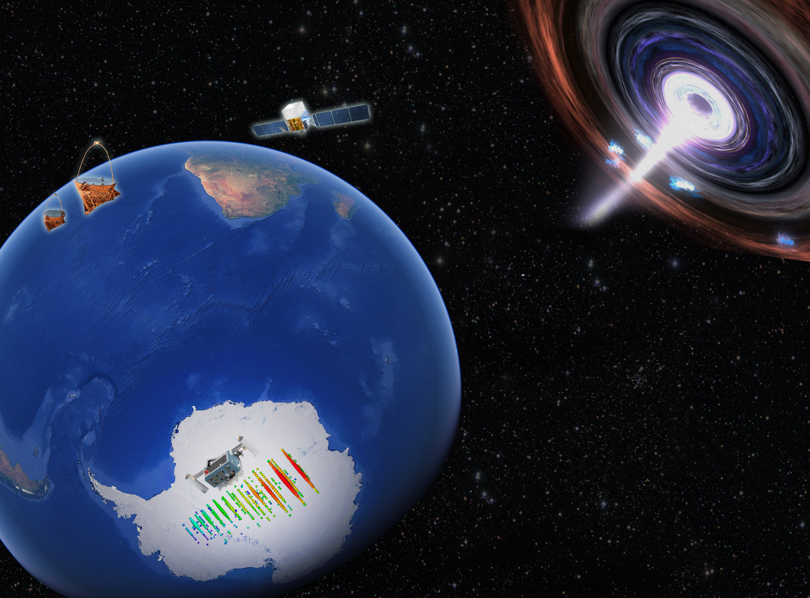


Observational constraints on neutrino emission by blazars
Justin Vandenbroucke (University of Wisconsin)
IceCube Collaboration
Understanding the multiwavelength blazar variability
KIPAC workshop, Stanford University, August 28, 2019
Notes:
Session: The multi-messenger future
Olivierr Hervet 30 min on CTA
Justin Vandenbroucke 30 min on neutrinos
Roger Blandford 30 min on “multi mesages”
Discussion 30 min
Coffee break 30 min
Noemi Globus 30 min on UHECR
Anita Reimer 15 min on modeling
Ke Fang 15 min on SS 433
Dmitry Blinov 15 min on optical-radio offsets
Questions received:
Any update on flavor ratio?
Are TXS neutrino and gamma luminosities isotropic equivalent?
What are the excluded sectors on Gen 2 array layout diagram?
What technical lessons learned that you would do differently / next time in design/construction?
At low energy, is there any way to beat down the atmospheric neutrino background?
Is the 10-year NGC 1068 all-sky / source list warm spot consistent with non-detection in 8 year results?
Is there any time variation in the NGC 1068 warm spot (maybe indicated by difference from 8 year results)?
What are latest results from correlation with large-scale structure? Can this be used to constrain distance to sources?

Slide 2
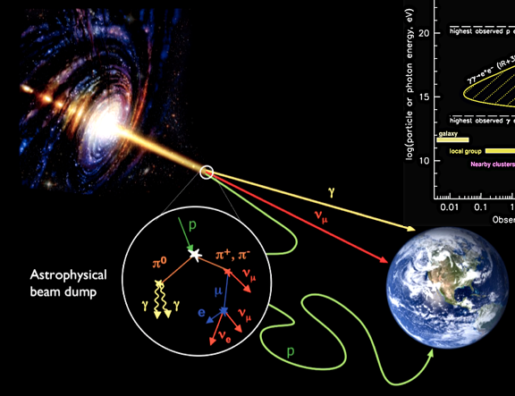
Neutrinos and electromagnetic signals (esp. gamma rays) are complementary
Neutrinos indicate a hadronic (or exotic) source
Notes:
At 1 TeV cross section is ~10^-12 mb (Formaggio)

Slide 3
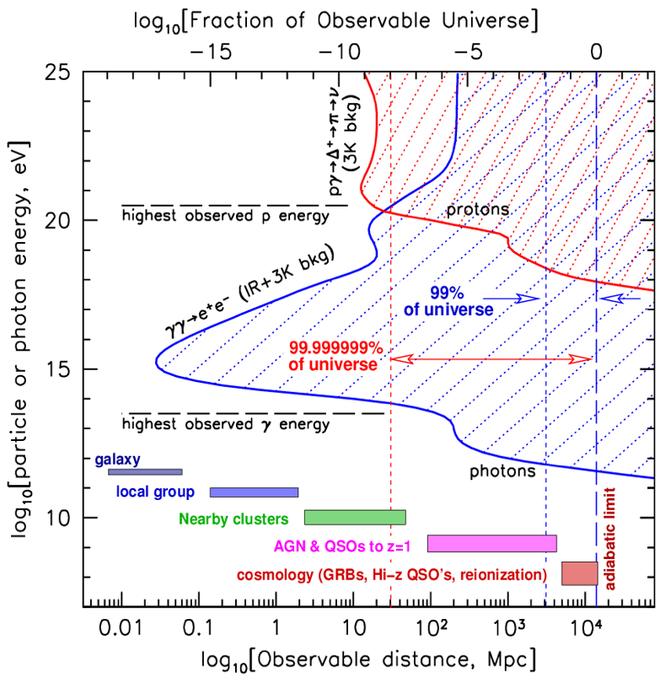
Neutrinos complement gamma rays and cosmic rays
100 EeV
1 TeV
Notes:
Redshift of 0.1 tau=1 for 1 TeV
z = 0.01: 40 Mpc
z = 0.1: 400 Mpc
z = 1: 4 Gpc
TODO: Z burst back of envelope

Slide 4
Gamma rays, neutrinos, and cosmic rays
all have ~equal energy density
L. Mohrmann, PhD thesis
This implies there is likely a strong connection among them
Despite this, sky looks very different in each messenger
Notes:
From Lars Mohrmann, DESY Zeuthen PhD thesis
E^2 dN/dE: erg^2 * /cm^2/erg/s = erg/cm^2/s
Nu F_nu: erg * erg/cm^2/erg/s = erg/cm^2/s

Slide 5
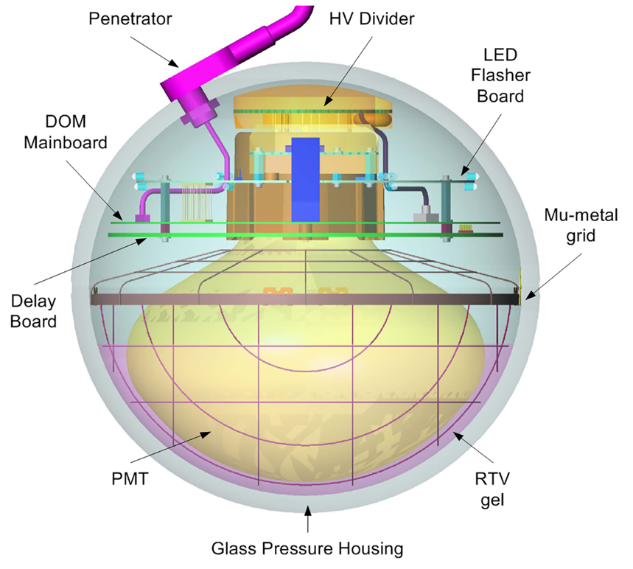
The IceCube Neutrino Observatory
IceTop (surface array): 81 stations
IceCube: 86 strings
5160 optical sensors over 1 km³ volume
17 m vertical spacing
125 m horizontal spacing
DeepCore (low energy threshold)
Notes:
IceTop: 81x2 tanks, 324 optical sensors
DeepCore: 8 strings, 480 optical sensors
Larger than most radio telescopes including FAST but not Molonglo
Molonglo: 1.6 km x 12 m
FAST: 0.5 km
CHIME: 20 x 100 m

Slide 6
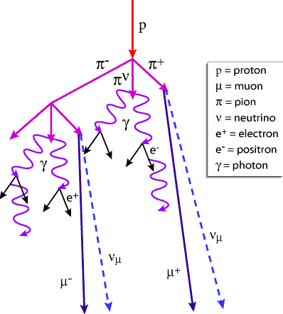
IceCube signals and backgrounds
Atmospheric muons: 70 billion per year
Atmospheric neutrinos: one in 10³
Astrophysical neutrinos: one in 10⁸
Notes:
Francis: 550 cosmic neutrinos in the Aachen analysis on a background of 340,000
Waxman-Bahcall is scaled by 3/2 (why?)
Atmospheric neutrino production:
Cosmic rays produce muons, pions, kaons which decay to neutrinos
Toward horizon, more atmosphere column depth within which particles can decay before being absorbed by Earth
Prompt/charm: don’t need path length to decay

Slide 7
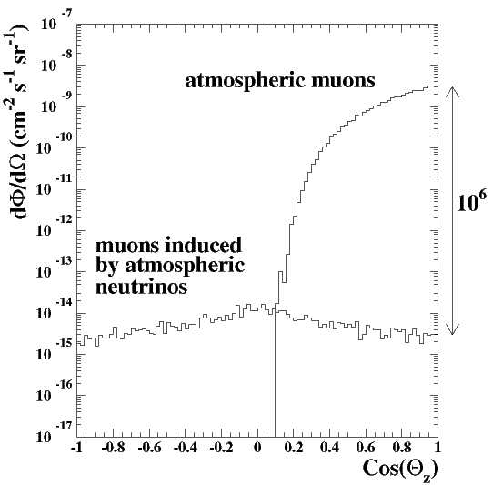
IceCube signals and backgrounds
Most events detected by IceCube are not astrophysical neutrinos
atmospheric μ ~70 billion / year
atmospheric ν_{μ} → μ ~80 thousand / year
astrophysical ν_{μ} → μ ~10 / year above 200 TeV
Background and signal differ in spectrum and angular distribution
energy distribution
angular distribution
conventional
atmospheric
atmospheric muons
astrophysical
atmospheric neutrinos
prompt atmospheric
cosmogenic
up-going
down-going
Notes:
Francis: 550 cosmic neutrinos in the Aachen analysis on a background of 340,000
Waxman-Bahcall is scaled by 3/2 (why?)
Atmospheric neutrino production:
Cosmic rays produce muons, pions, kaons which decay to neutrinos
Toward horizon, more atmosphere column depth within which particles can decay before being absorbed by Earth
Prompt/charm: don’t need path length to decay
80e3/70e9= 1e-6

Slide 8
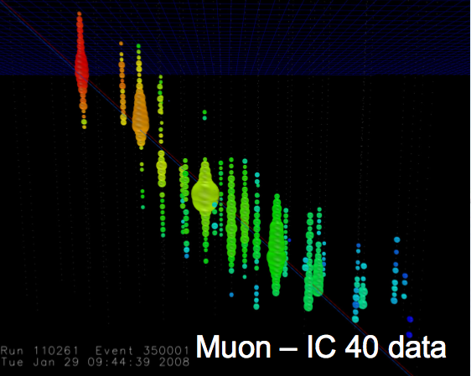
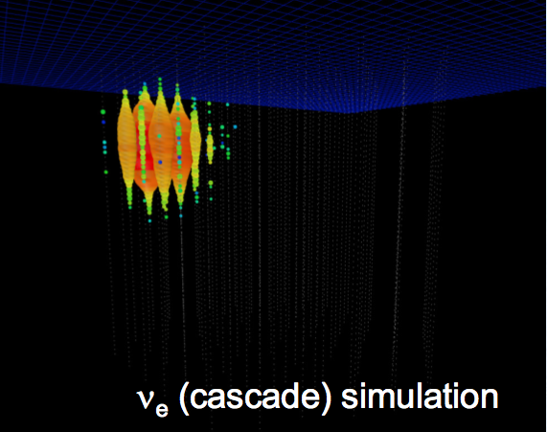
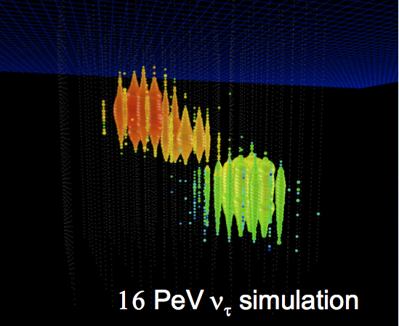
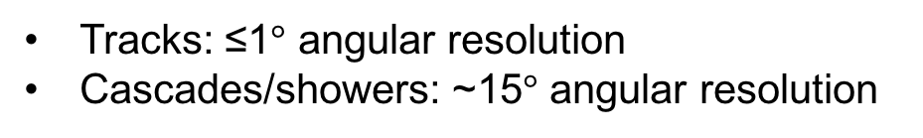
Interaction channels and flavor identification
Muon neutrino
+ Straight track,
points to neutrino source,
angular resolution ~1°
- Cosmic-ray muon background
Electron neutrino
+ Good energy resolution
- Cascade, ideally in detector
- Poor angular resolution
Tau neutrino
+ Double bang signature,
low background
+ Pointing capability
- Low rate
Tracks: ≤1$°$ angular resolution
Cascades/showers: ~15$°$ angular resolution
Notes:
Tau decay length vs. energy
Muon is IC 40 data

Slide 9
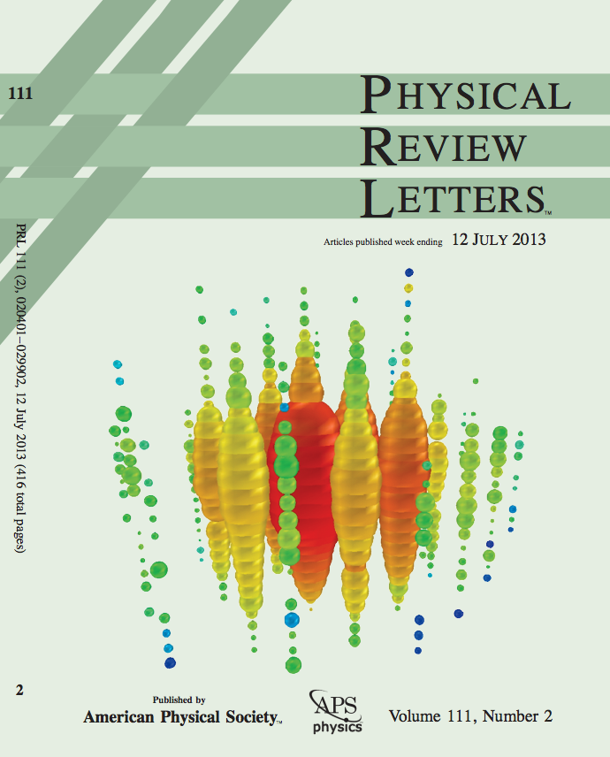
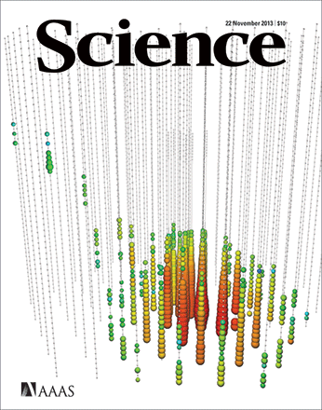
Discovery of a diffuse astrophysical neutrino flux
Two PeV events in two years (2.8 σ)
28 additional events in two years (4.1 σ)
IceCube, PRL 111, 021103 (2013)
IceCube, Science 342, 1242856 (2013)
IceCube, PRL 113, 101101 (2014)
Notes:
FIG.4 (color online). The two observed events from (a) August 2011 and (b) January 2012. Each sphere represents a DOM. Colors represent the arrival times of the photons where red indicates early and blue late times. The size of the spheres is a measure for the recorded number of photoelectrons.
http://antarcticaneutrinos.blogspot.com/2013/04/bert-and-ernie-step-out.html
Bert (left), Ernie (right)

Slide 10
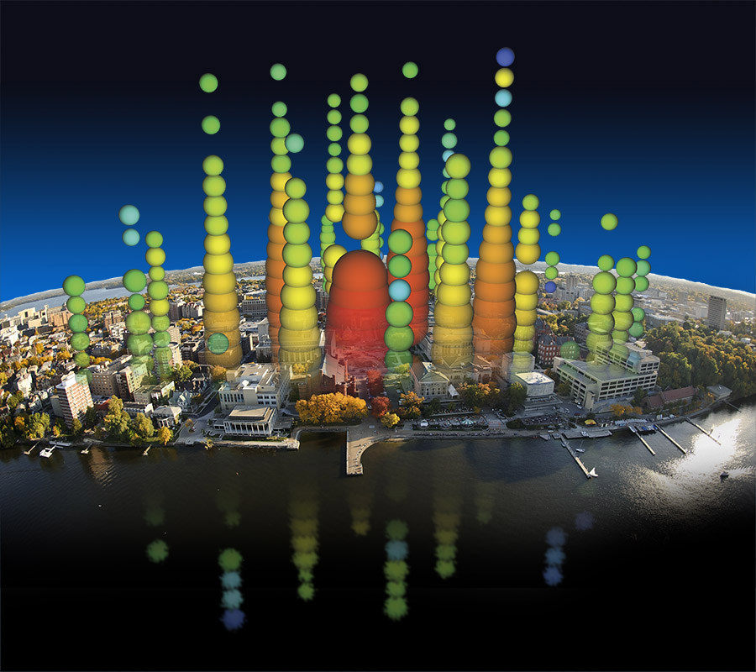
Notes:
Bert over Lake Mendota / Memorial Union Terrace

Slide 11
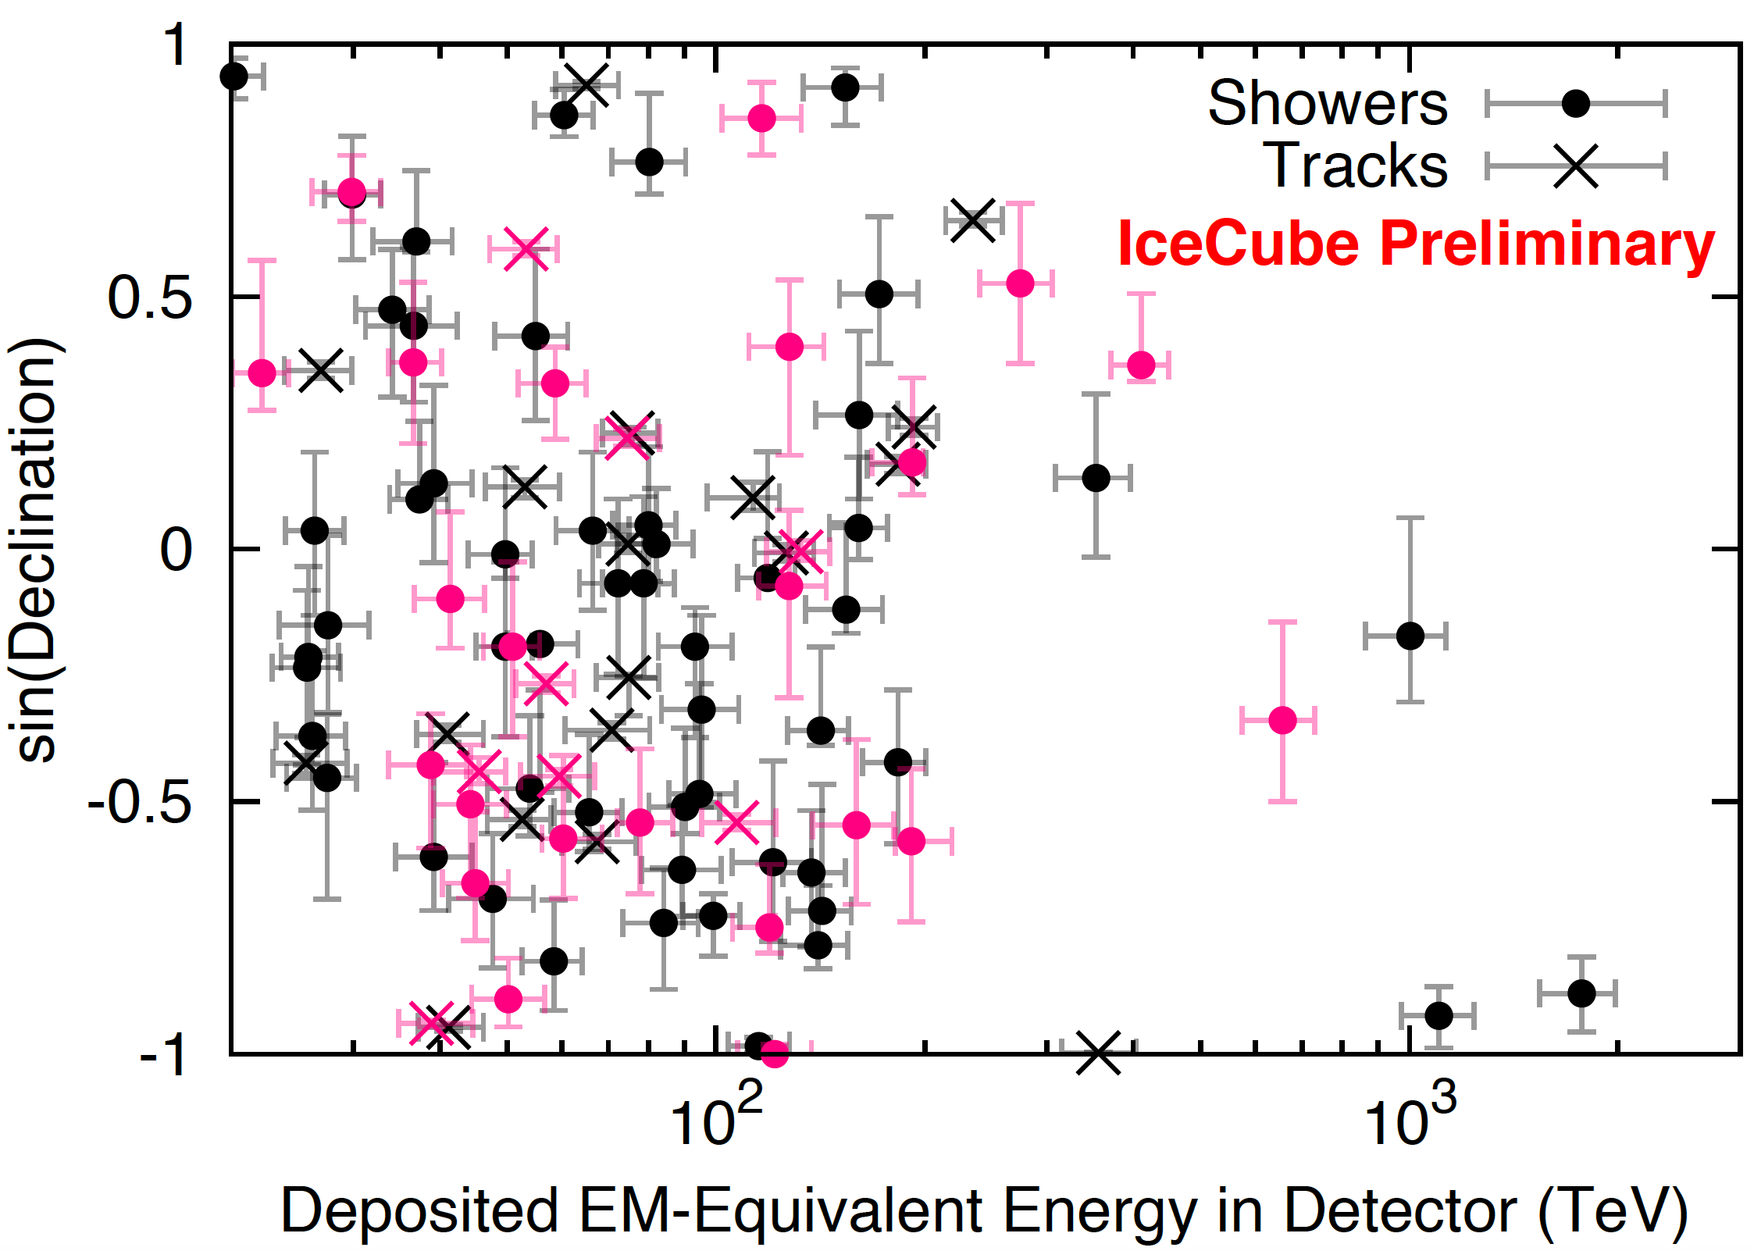
High-energy starting events (7.5 years)
103 events
Notes:
Figure 5: Arrival directions of the events in galactic coordinates. Shower-like events are marked with a + and those containing tracks with a ×. The new events of table 1 are shown in black. Colors show the test statistics (TS) for the point-source clustering test at each location. No significant clustering was found.
4 year was 6.5 sigma
2 of the 82 events have coincident muons
~8 sigma: Nancy Wandkowsky @ TeVPA 2017 (6 years of data)
More details on 6 year analysis:
1710.01191 (ICRC)
103 events out of which 60 have Edep > 60 TeV
75% astro purity above 60 TeV
Pink are new events in 7.5 yr analysis

Slide 12
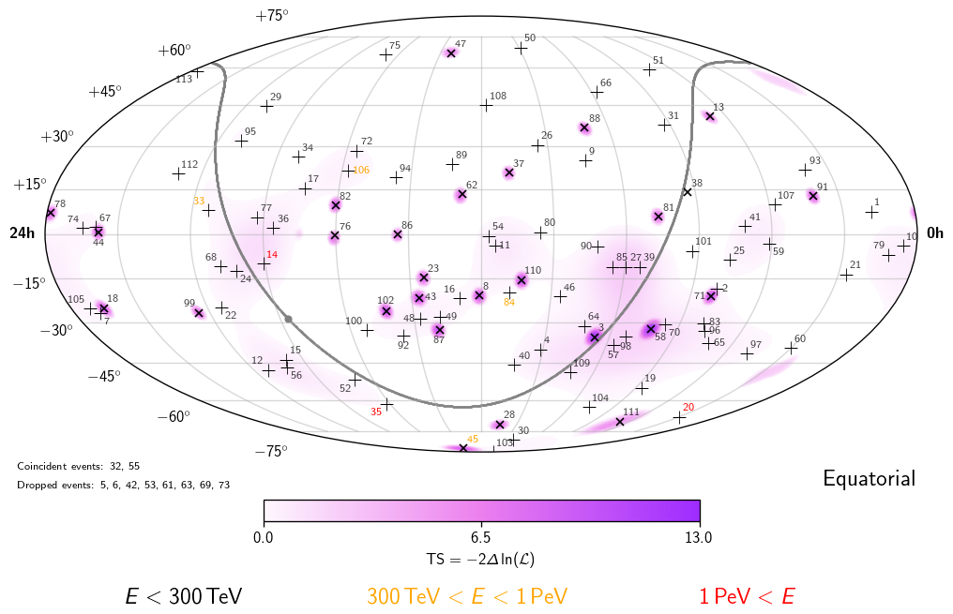
High-energy starting events (7.5 years)
Work in progress
103 events
>8 𝜎 detection of astrophysical neutrinos
No significant clustering observed (103 events)
Notes:
Figure 5: Arrival directions of the events in galactic coordinates. Shower-like events are marked with a + and those containing tracks with a ×. The new events of table 1 are shown in black. Colors show the test statistics (TS) for the point-source clustering test at each location. No significant clustering was found.
4 year was 6.5 sigma
2 of the 82 events have coincident muons
~8 sigma: Nancy Wandkowsky @ TeVPA 2017 (6 years of data)
More detials on 6 year analysis:
1710.01191 (ICRC)
TODO: dates of dataset; background fraction estimation and type of events; background fraction contamination for tracks vs. cascades
103 above ~20 TeV (cut is on Npe, not Edep)

Slide 13
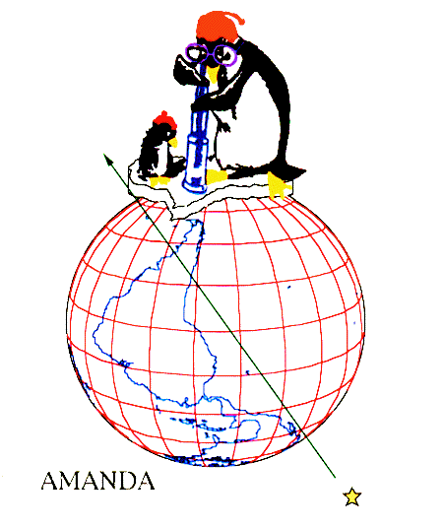
A more traditional search: up-going muon neutrinos from the Northern hemisphere

Slide 14
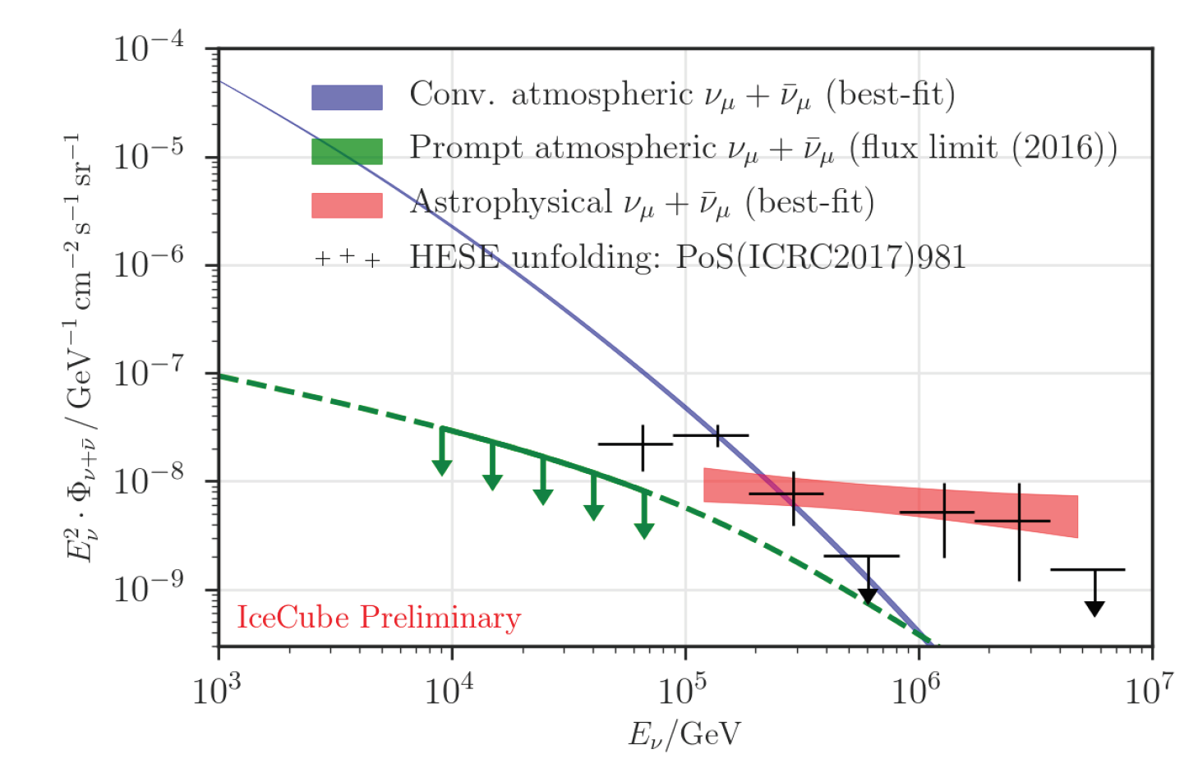
Through-going Northern tracks (8 years)
IceCube, 1710.01191 (ICRC)
IceCube, ApJ 833:3 (2016)
6.7 𝜎 significance
Astrophysical neutrinos
measured with two interaction and detection methods
Notes:
8 years of data
Published ApJ is 6 years
Significance: 5.6, 6.7 sigma respectively

Slide 15
Complementary analyses characterizing the diffuse astrophysical neutrino flux
IceCube, PoS (ICRC 2019) 1017
Three different event selections with complementary (and overlapping) coverage in terms of energy, declination, and flavor
Global fit underway to test whether simplest model (isotropic, equal-flavor power law) can explain all results
Notes:
Figure 5 Comparison of the best-fits and profile likelihood contours (68% and 95% CL) of different IceCube analyses measuring the astrophysical flux, assuming a single power-law energy spectrum. The y-axis shows the per-flavor normalization anchored at 100 TeV.
For each flavor, if E^{-2.3} then ~1.5 x 10⁻¹⁸ /GeV/cm2/s/sr normalization at 100 TeV
For simplicity: consider E^{-2.0} and (1 x 10⁻¹⁸ /cm2/s/sr/GeV)*(1000 GeV / TeV) normalization at 100 TeV
For E-2, same normalization at any reference energy
= 1 x 10⁻¹⁵ /cm2/s/sr/TeV
Integrate over 4pi ski:
dN/dA/dt/dE = 1.3 x 10⁻¹⁴ /cm2/s/TeV normalization at 100 TeV
So E2 dN/dA/dt/dE =

Slide 16
All-sky search for discrete neutrino sources (neutrino clusters)
7 year dataset
IceCube, ApJ 835:151 (2017)
Comparing the measured diffuse flux with point source upper limits: there are at least ~10² sources
Notes:
Left:
Figure 6. All-sky result of the unbinned likelihood maximization shown in equatorial coordinates (J2000). Shown is the negative logarithm of the pre-trial p-value, -log10 p, assuming no clustering as the null hypothesis. The Galactic plane is shown as the black line.
Right:
Figure 8. Discovery potential (5σ, solid red) and sensitivity (dashed red) for a numu + numubar unbroken E^2 dphi/dE flux shown against declination δ. The gray line shows the results of Adrian-Martinez et al. (2014) in the south. Upper limits of source candidates in Table 2 and Table 3 are depicted by red crosses. The blue line represents the upper limit for the observed most significant spots in each half of the sky for all declinations; the actual declination position of the spots is indicated by a star.
add calculation of >100 sources
Which 7 years of data
Most stringent pt src UL: E² dN/dE = ~4e-13 TeV/cm²/s assuming E⁻²
Is this for numu flavor only?

Slide 17
What is producing the neutrinos? constraining candidate sources and source classes
Blazars (time averaged)
Blazars (flares)
Gamma-ray bursts
Star-forming galaxies
Galaxy clusters
Supernovae
Galactic diffuse emission
Discrete Galactic sources
Binary black hole or neutron star mergers
Novae
Tidal disruption events
Fast radio bursts
Heavy dark matter
Notes:
Todo: Add dark matter backup slides

Slide 18
IceCube provides public real-time alerts to guide pointed observatories (radio, optical, x-ray, gamma-ray, …)
Real time (~1 minute) public alerts since 2016
25 alerts to date (8/year)
IceCube, 1309.6979 (ICRC)
IceCube, Astropart. Phys. 92 (2017) 30-41
Notes:
TODO: update as of August 28
https://gcn.gsfc.nasa.gov/amon_ehe_events.html (8 as of Mar 27 2019)
https://gcn.gsfc.nasa.gov/amon_hese_events.html (15 as of Mar 27 2019)
17+9-1=25 total
First alert issued April 27, 2016
As of May 21 2019: 37 months of alerts
25 / (3.1) = 8.1 per year
Most recent Feb 21, 2019 (as of Mar 27 2019: 35 months of alerts)
HESE events:
1) 160427
2) 160731 (also EHE)
4) 160814
5) 161103
7) 170312
9) 170506
11) 171015
12) 171028
14) 180423
16) 181014
17) 181031
18) 190104
19) 190124
20) 190205
21) 190221
22) 190331
23) 190504
EHE events:
2) 160731 1:55:04.00 [GCN 1:55:45 HESE and 1:55:58 EHE; revised 160801 2:35:38 HESE and 2:35:54 EHE]
3) 160806 12:21:33.00 [GCN 12:22:10]; latency (22*60+10) – (21*60+33.00) = 37 sec
6) 161210 20:06:40.31 [GCN 20:07:16; revised 161211 16:04:50]; latency (7*60+16) - (6*60+40.31) = 35.69 sec
8) 170321 07:32:20.69 [GCN 7:32:58]; latency = (32*60+58) - (32*60+20.69) = 37.31 sec
10) 170922 20:54:30.43 [GCN 20:55:13]: latency = (55*60+13) - (54*60+30.43) = 42.57 sec
13) 171106 18:39:39.21 [GCN 18:40:24]: latency = (40*60+24) - (39*60+39.21) = 44.79 sec sec
15) 180908
17) 181023
18) 190503
But when did EHE start?
Rate: 22 / 2.9 = 7.5 alerts per year

Slide 19
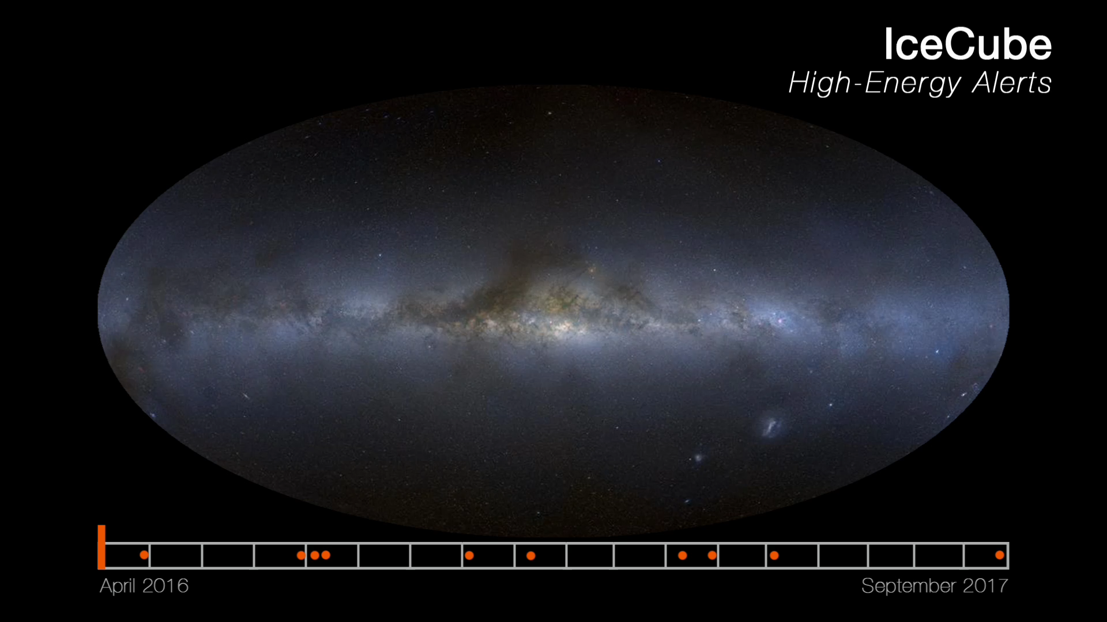
The first 10 IceCube real-time, public alerts

Slide 20
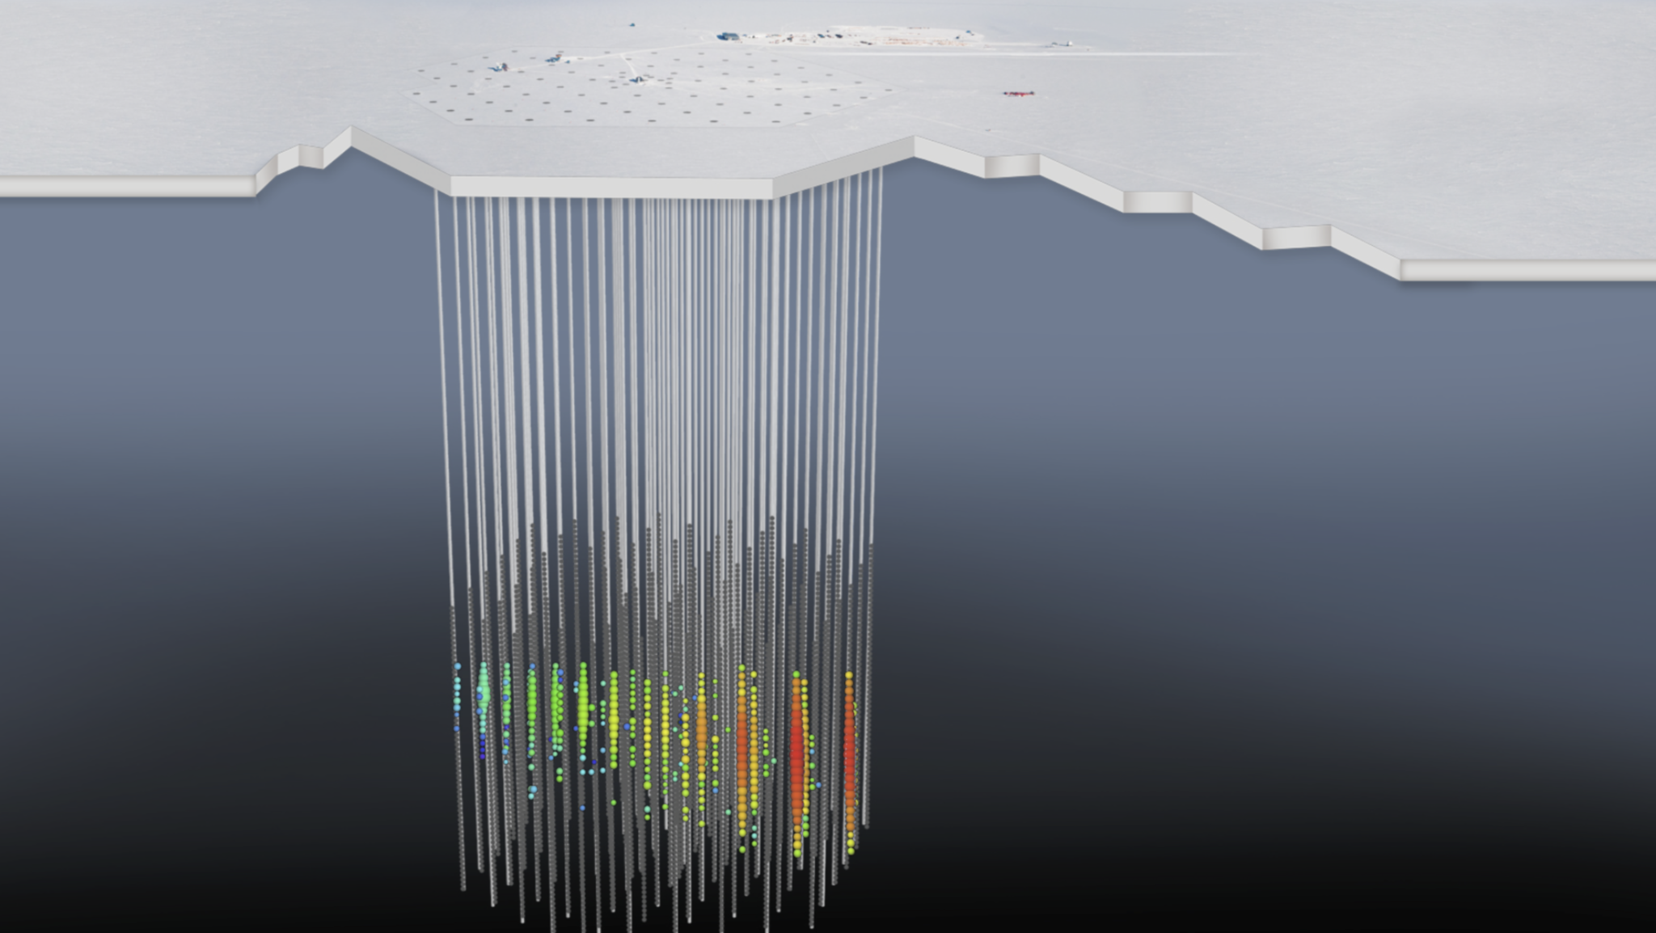
IceCube-170922A
A track with angular uncertainty ~1°
Declination +5.7°, deposited energy 24 TeV, neutrino energy ~290 TeV
Announced in public alert (GCN) 43 seconds after interaction
Notes:
Enu > 183 TeV at 90% CL

Slide 21
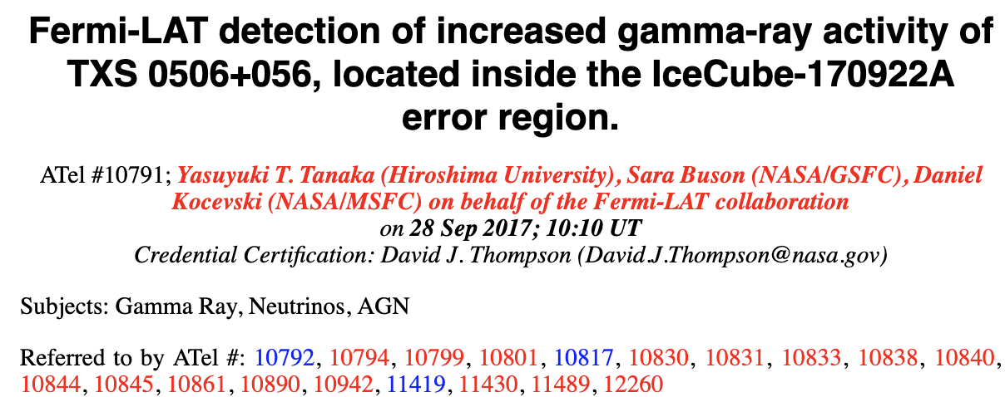
Fermi LAT: there was a flaring blazar coincident with IceCube-170922A
TXS 0506+056: 3FGL J0509.4+0541 (and 3FHL)
Sep 15-27, 2017: 6x higher flux (>100 MeV) than 3FGL (2.0±0.1 index)
OVRO, MOJAVE: increasing flux in prior year

Slide 22
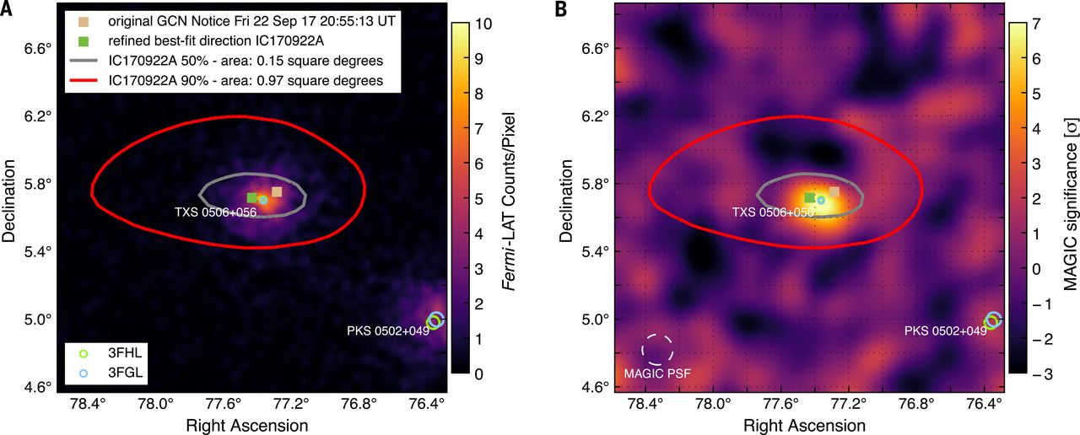
A GeV gamma-ray blazar in the same direction as the ~290 TeV neutrino
IceCube+,
Science 361, eaat1378 (2018)
0.1°separation between blazar and best-fit neutrino direction
Rejection of chance coincidence? 3 𝜎
Notes:
Fig. 2. Fermi-LAT and MAGIC observations of IceCube-170922A’s location. Sky position of IceCube-170922A in J2000 equatorial coordinates overlaying the g-ray counts from Fermi-LAT above 1 GeV (A) and the signal significance as observed by MAGIC (B) in this region. The tan square indicates the position reported in the initial alert, and the green square indicates the final best-fitting position from follow-up reconstructions (18). Gray and red curves show the 50% and 90% neutrino containment regions, respectively, including statistical and systematic errors. Fermi-LAT data are shown as a photon counts map in 9.5 years of data in units of counts per
pixel, using detected photons with energy of 1 to 300 GeV in a 2° by 2° region around TXS0506+056. The map has a pixel size of 0.02° and was smoothed with a 0.02°-wide Gaussian kernel. MAGIC data are shown as signal significance for g-rays above 90 GeV. Also shown are the locations of a g-ray source observed by Fermi-LAT as given in the Fermi-LAT Third Source Catalog (3FGL) (23) and the Third Catalog of Hard Fermi-LAT Sources (3FHL) (24) source catalogs, including the identified positionally coincident 3FGL object TXS 0506+056. For Fermi-LAT catalog objects, marker sizes indicate the 95% CL positional uncertainty of the source.

Slide 23
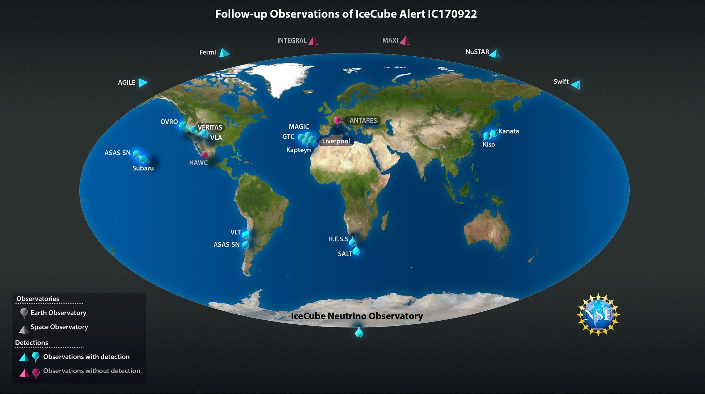
Follow-up of IceCube-170922A by 23 observatories

Slide 24
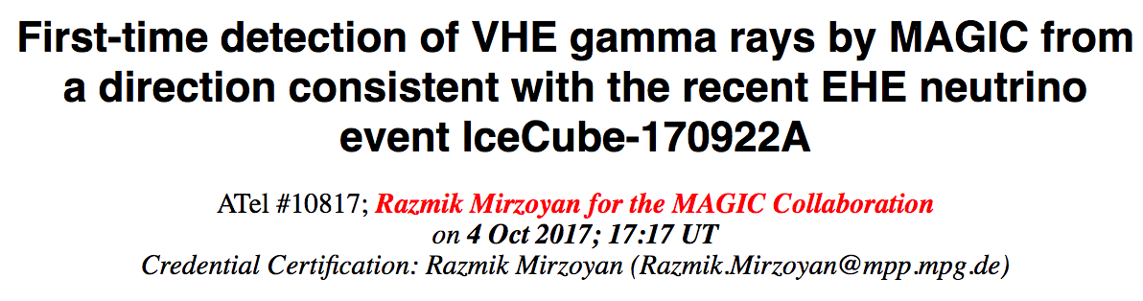
IceCube-170922A: a muon neutrino in the direction of a flaring GeV-TeV blazar
An event selected with extremely high energy (EHE) event selection (simple requirement of large light deposit)
Track with ~1°angular resolution, declination = +5.7°
43 seconds from neutrino interaction to GCN publication
Coincident with known, flaring Fermi blazar (TXS 0506+056, a BL Lac)
No previously known very-high-energy gamma-ray source
Not detected by initial H.E.S.S., VERITAS follow-up
In 12-hour follow-up observation, MAGIC detected 5 σ source above 100 GeV
Subsequent detection by VERITAS
24 Astronomers Telegrams; measured z = 0.3365 (Paiano et al. 2018)
Notes:
z = 0.3365:
Angular diameter distance 1 Gpc
Luminosity distance 2 Gpc
It is a BL Lac
https://heasarc.gsfc.nasa.gov/W3Browse/radio-catalog/texas.html
TEXAS - Texas Survey of Radio Sources at 365 MHz
“The University of Texas Radio Astronomy Observatory (UTRAO) carried out, with the Texas Interferometer, this 365 MHz survey of the sky”

Slide 25
First detection of ~TeV gamma rays from the same direction as a high-energy neutrino
IceCube+, Science 361, eaat1378 (2018)
Original 𝜈 GCN
Refined 𝜈 position
MAGIC detection
up to ~0.4 TeV
Notes:
Fig. 2. Fermi-LAT and MAGIC observations of IceCube-170922A’s location. Sky position of IceCube-170922A in J2000 equatorial coordinates overlaying the g-ray counts from Fermi-LAT above 1 GeV (A) and the signal significance as observed by MAGIC (B) in this region. The tan square indicates the position reported in the initial alert, and the green square indicates the final best-fitting position from follow-up reconstructions (18). Gray and red curves show the 50% and 90% neutrino containment regions, respectively, including statistical and systematic errors. Fermi-LAT data are shown as a photon counts map in 9.5 years of data in units of counts per
pixel, using detected photons with energy of 1 to 300 GeV in a 2° by 2° region around TXS0506+056. The map has a pixel size of 0.02° and was smoothed with a 0.02°-wide Gaussian kernel. MAGIC data are shown as signal significance for g-rays above 90 GeV. Also shown are the locations of a g-ray source observed by Fermi-LAT as given in the Fermi-LAT Third Source Catalog (3FGL) (23) and the Third Catalog of Hard Fermi-LAT Sources (3FHL) (24) source catalogs, including the identified positionally coincident 3FGL object TXS 0506+056. For Fermi-LAT catalog objects, marker sizes indicate the 95% CL positional uncertainty of the source.

Slide 26
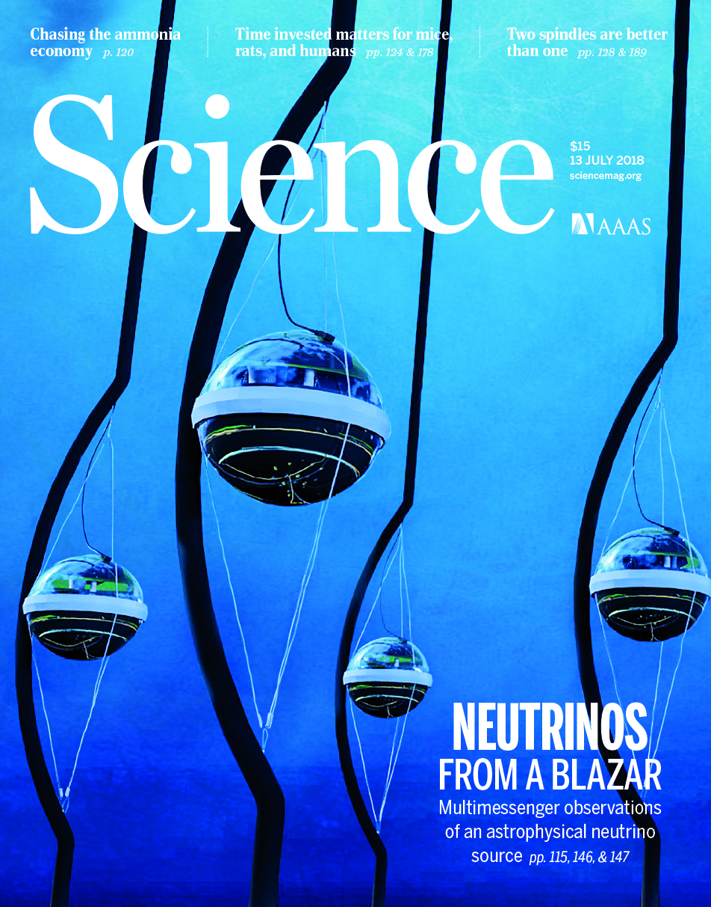
Neutrinos from blazar TXS 0506+056: two papers
“Multimessenger observations of a flaring blazar coincident with high-energy neutrino IceCube-170922A”
“Neutrino emission from the direction of the blazar TXS 0506+056 prior to the IceCube-170922A alert”

Slide 27
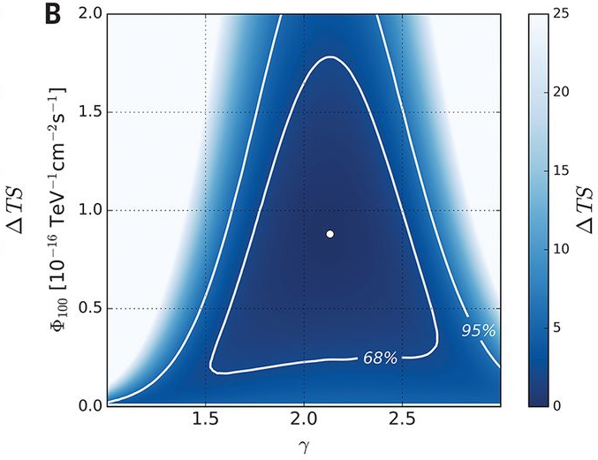
Archival IceCube data in the direction of
TXS 0506+056
IceCube, Science 361, 147 (2018)
First 7 years
Entire 9.5 year archive (time-averaged emission): 4.1 𝜎
First 7 years (excluding 170922A): 2.1 𝜎 (p = 1.6%)
Notes:
As in Fig. 3A, but for the time-integrated analysis of TXS 0506+056 using (A) the full 9.5-year sample (2008–2017), and (B) the 7-year sample (2008–2015).

Slide 28
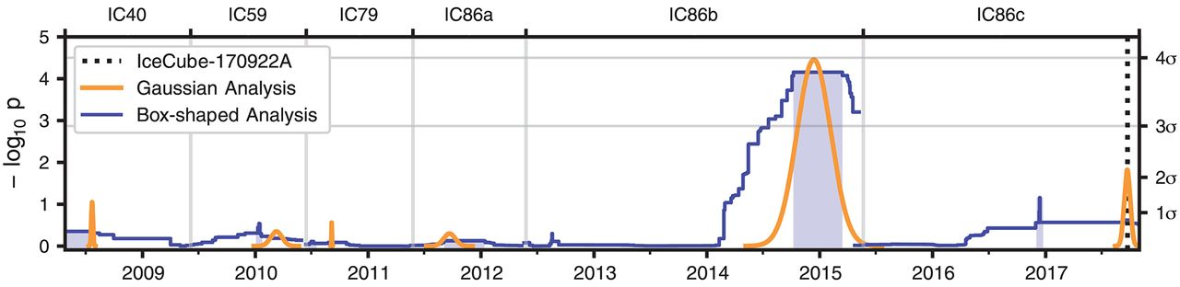
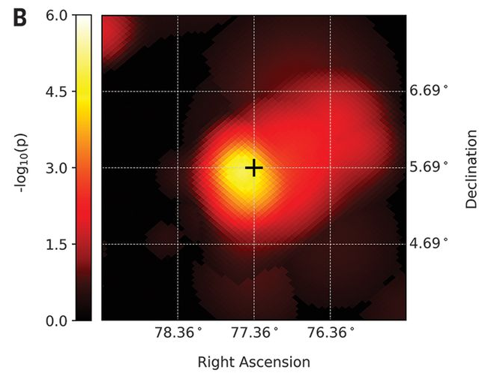
Archival IceCube data in the direction of
TXS 0506+056
IceCube, Science 361, 147 (2018)
3.5 𝜎 evidence for a neutrino flare in late 2014 – early 2015 (long before 170922A)
  158 day duration (box profile)
  110 day duration (Gaussian)
13±5 excess neutrinos above atmospheric background (un-binned maximum likelihood analysis)
Notes:
The orange curve corresponds to the analysis using the Gaussian-shaped time profile. The central time T₀ and width T_{W} are plotted for the most significant excess found in each period, with the P value of that result indicated by the height of the peak. The blue curve corresponds to the analysis using the box-shaped time profile. The curve traces the outer edge of the superposition of the best-fitting time windows (durations T_{W}) over all times T₀, with the height indicating the significance of that window. In each period, the most significant time window forms a plateau, shaded in blue. The large blue band centered near 2015 represents the best-fitting 158-day time window found using the box-shaped time profile. The vertical dotted line in IC86c indicates the time of the IceCube-170922A event.
Skymap showing the P value of the time-dependent analysis performed at the coordinates of TXS 0506+056 (cross) and at surrounding locations. The analysis is performed on the IC86b data period, using the Gaussian-shaped time window. At each point, the full fit for (Φ, γ, T₀, T_{W}) is performed. The P value shown does not include the look-elsewhere effect related to other data periods. An excess of events is detected, consistent with the position of TXS 0506+056.
Gaussian duration: 110 (+35, -24) days
Box duration: 158 days (no uncertainty estimate provided)

Slide 29
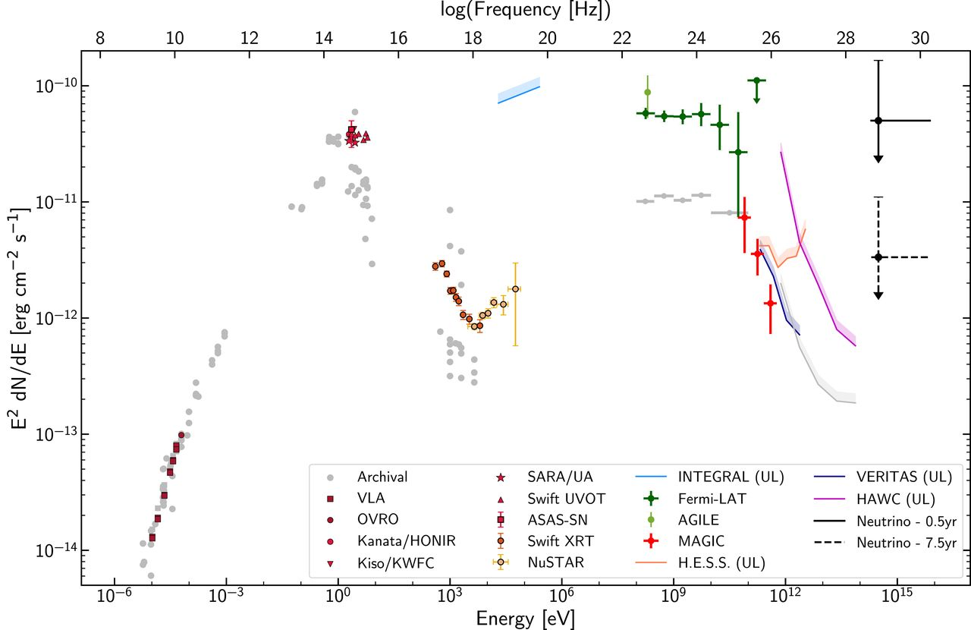
TXS 0506+056: Spectral energy distribution
IceCube+, Science 361, eaat1378 (2018)
Notes:
The SED is based on observations obtained within 14 days of the detection of the IceCube-170922A event. The vertical axis is equivalent to a scale. Contributions are provided by the following instruments: VLA (38), OVRO (39), Kanata Hiroshima Optical and Near-InfraRed camera (HONIR) (52), Kiso, and the Kiso Wide Field Camera (KWFC) (43), Southeastern Association for Research in Astronomy Observatory (SARA/UA) (53), ASAS-SN (54), SwiftUltraviolet and Optical Telescope (UVOT) and XRT (55), NuSTAR (56), INTEGRAL(57), AGILE (58), Fermi-LAT (16), MAGIC (35), VERITAS (59), H.E.S.S. (60), and HAWC (61). Specific observation dates and times are provided in (25). Differential flux upper limits (shown as colored bands and indicated as “UL” in the legend) are quoted at the 95% CL, while markers indicate significant detections. Archival observations are shown in gray to illustrate the historical flux level of the blazar in the radio-to-keV range as retrieved from the ASDC SED Builder (62), and in the γ-ray band as listed in the Fermi-LAT 3FGL catalog (23) and from an analysis of 2.5 years of HAWC data. The γ-ray observations have not been corrected for absorption owing to the EBL. SARA/UA, ASAS-SN, and Kiso/KWFC observations have not been corrected for Galactic attenuation. The electromagnetic SED displays a double-bump structure, one peaking in the optical-ultraviolet range and the second one in the GeV range, which is characteristic of the nonthermal emission from blazars. Even within this 14-day period, there is variability observed in several of the energy bands shown (see Fig. 3), and the data are not all obtained simultaneously. Representative neutrino flux upper limits that produce on average one detection like IceCube-170922A over a period of 0.5 (solid black line) and 7.5 years (dashed black line) are shown, assuming a spectrum of at the most probable neutrino energy (311 TeV).

Slide 30
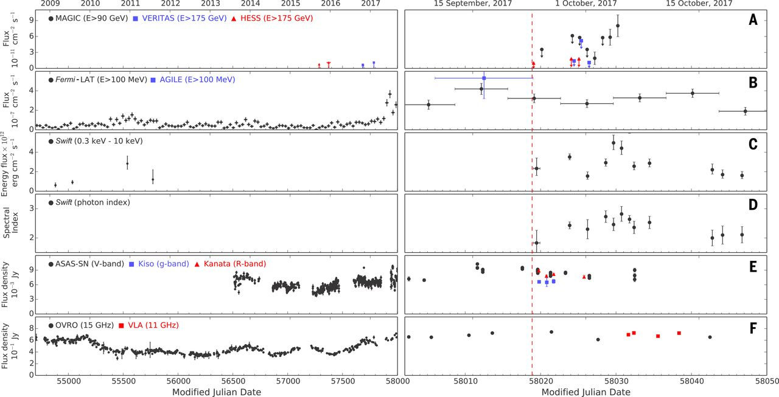
TXS 0506+056: Multi-wavelength light curves
Sep 22, 2017
VHE
HE
X-ray
X-ray index
optical
radio
IceCube+, Science 361, eaat1378 (2018)
Notes:
Significant variability of the electromagnetic emission can be observed in all displayed energy bands, with the source being in a high-emission state around the time of the neutrino alert. From top to bottom: (A) VHE γ-ray observations by MAGIC, H.E.S.S., and VERITAS; (B) high-energy γ-ray observations by Fermi-LAT and AGILE; (C and D) x-ray observations by Swift XRT; (E) optical light curves from ASAS-SN, Kiso/KWFC, and Kanata/HONIR; and (F) radio observations by OVRO and VLA. The red dashed line marks the detection time of the neutrino IceCube-170922A. The left set of panels shows measurements between MJD 54700 (22 August 2008) and MJD 58002 (6 September 2017). The set of panels on the right shows an expanded scale for time range MJD 58002 to MJD 58050 (24 October 2017). The Fermi-LAT light curve is binned in 28-day bins on the left panel, while finer 7-day bins are used on the expanded panel. A VERITAS limit from MJD 58019.40 (23 September 2017) of is off the scale of the plot and not shown.

Slide 31
TXS 0506+056: gamma and neutrino luminosity
HE gamma luminosity (LAT >0.1 GeV)
  2.8 x 10⁴⁶ erg/s (10-year average)
  13 x 10⁴⁶ erg/s (±2 weeks around IceCube-170922A)
  2.8 x 10⁴⁶ erg/s (158 day 2014-2015 average)
VHE neutrino luminosity (IceCube)
  0.48 x 10⁴⁶ erg/s (9.5-year average)
  7.2 x 10⁴⁶ erg/s (6 months centered on IceCube-170922A)
  12 x 10⁴⁶ erg/s (158 day 2014-2015 average)
Sep 22, 2017 : 5x elevated gamma flux
2014-2015 flare: gamma flux same as average
In 3LAC, top 2.9% of AGN by >1 GeV photon flux (#51 of 1773)
In 3FGL, top 5.4% of all sources by >1 GeV flux (#163 of 3034)
One of the most GeV-luminous blazars (order of magnitude greater luminosity than nearby blazars Mrk 421, Mrk 501, 1ES 1959+650)
(see 2 Science papers)
Notes:
3LAC / 3FGL table values:
>1 GeV photon flux: (6.51 ± 0.228) e-9 ph/cm^2/s
Index:
RA, Dec = 77.3639°, 5.699°
54.5 sigma

Slide 32
New: July 2019 neutrino-blazar coincidence
IceCube-190730A, another very-high-energy neutrino (GCN Circular #25225, ATel #12967)
Coincident with blazar PKS 1502+106 (4FGL J1504.4+1029 and 3FHL): 0.31°offset, within 50% CL region of neutrino
FSRQ at z=1.84
OVRO 40m telescope: a 15 GHz flare started 5 years ago and now reaching all-time high 4 Jy (similar to TXS 0506+056)
Neutrino “signalness” 67%
9 ATels: IceCube, radio (OVRO & VLA), Swift, optical (ZTF, MASTER, Alabama), ASKAP
Notes:
OVRO: astronomerstelegram.org/?read=12996

Slide 33
Overall: astrophysical neutrinos are not well correlated with Fermi LAT detected blazars
IceCube, ApJ 835:45 (2017)
Search for correlation between IceCube neutrinos and GeV blazars
Fermi 2LAC sample: 862 blazars
Lack of detection constrains contribution of 2LAC blazar class to at most
  27% of neutrino signal assuming equal weighting among blazars
  7% of neutrino signal assuming neutrino flux proportional to gamma flux
Notes:
Figure 5. 90% C.L. flux upper limits for all 2LAC blazars in comparison to the observed astrophysical diffuse neutrino flux. The latest combined diffuse neutrino flux results from Aartsen et al. (2015b) are plotted as the best-fit power law with a spectral index of −2.5 and as a differential flux unfolding using 68% central and 90% U.L. confidence intervals. The flux upper limit is shown using both weighting schemes for a power law with a spectral index of −2.5 (blue). Percentages denote the fraction of the upper limit compared to the astrophysical best-fit value. The equal-weighting upper limit for a flux with a harder spectral index of −2.2 is shown in green.

Slide 34
New: Updated neutrino-blazar correlation search
IceCube, PoS (ICRC 2019) 916
1908.08458
Updated Fermi LAT catalog: from 2LAC to 3FHL
8 years of Northern hemisphere IceCube data
The diffuse neutrino flux is not produced by any simple subset of Fermi LAT selected blazars
A small subset (~10²) of Fermi LAT detected blazars could explain the diffuse neutrino flux, but no obvious subset does
Notes:
Figure 3: Right: 90 % C.L. ν μ + ν ̄ μ
limit on the average flux of all blazars from the 3FHL catalog for γ = 2.19. The blue shaded band shows the 68 % C.L. band for the average muon neutrino flux of TXS, assuming that TXS 0506+056 is a steady neutrino source over ∼ 8 years of measurement. The dashed band represents the average flux of this blazar during the 158 d flaring period in 2014/2015. The data for both bands are taken from [2]. Note that the HESE spectrum as well as the diffuse muon neutrino flux are integrated over the northern hemisphere
Figure from source at https://arxiv.org/abs/1908.08458

Slide 35
Updated neutrino - blazar correlation search: subsets
IceCube, PoS (ICRC 2019) 916
1908.08458
4 sets of Northern 3FHL blazars: all, FSRQ, HBL, IBL/LBL
Notes:
Figure 3: Left: 90 % C.L. upper limits for blazar populations from the 3FHL catalog for γ = 2.
The dark-shaded bands illustrate the 1σ central band which arise from different weighting schemes
for the individual sources. The energy ranges mark the 90 % region where IceCube has the highest
exclusion power for the particular model. The best fit to the astrophysical diffuse muon neutrino
flux φ astro from [10, 11] including the 68 % C.L. contours is displayed in red.
Figure from source at https://arxiv.org/abs/1908.08458

Slide 36
New: 10-year general point source search
NGC 1068
IceCube,
PoS (ICRC 2019)851
1908.05993
All-sky search: 4π
Source list search: 110 gamma-selected targets
Most significant candidate source coincides with most significant all-sky search: NGC 1068 / M77: Seyfert II galaxy
Source list significance: 4.1 𝜎 pre-trial, 2.9 𝜎 post-trial
Best fit parameters: spectral index = 3.2, number of signal neutrinos = 50.4
Notes:
Caveat: *Northern*
0.35° offset
Southern catalog: p=0.059 for PKS 2233-148 (0.55 post-trials)
Seyferts based on optical
I vs. II: emission lines
Seyfert I: broadallowed lines and narrow forbidden lines, all broader than in normal galaxies; observe central source directly
Seyfert II: only narrow lines, both allowed and forbidden (electron transitions that can occur spontaneously but forbidden / improbable stimulated according to QM selection rules); AGN are obscured; only colder outer regions are seen
Figure from source at https://arxiv.org/abs/1908.05993

Slide 37
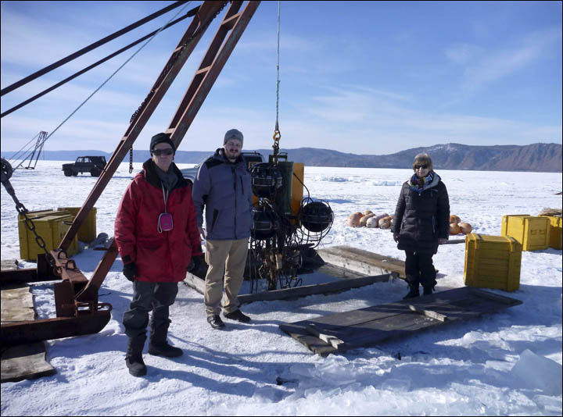
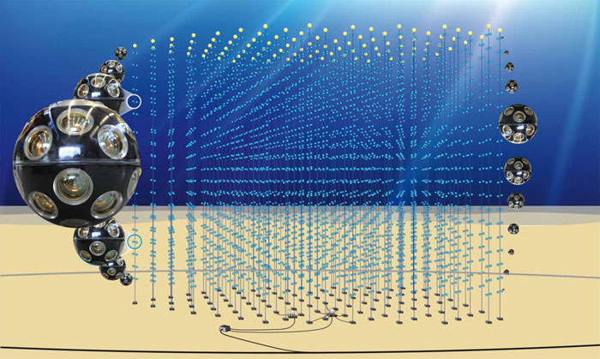
Looking to the future with neutrino telescopes
IceCube Gen 2
Km3Net
Baikal GVD

Slide 38
IceCube Gen 2: the next generation
High energy extension: Instrument ~10 km³ (sparsely with ~120 new strings) to increase sensitivity to high energy (0.1-10 PeV) muon and cascade events
Surface array for increased southern sky sensitivity and cosmic-ray physics
Identify neutrino sources and study them with multiple messengers
Dense inner core for neutrino physics including mass hierarchy
Radio Neutrino Observatory for ~10¹⁸ eV neutrinos
IceCube, 1412.5106 (LOI)
IceCube, 1510.05228 (ICRC)
Notes:
PINGU LOI: 1401.2046

Slide 39
IceCube Upgrade (first step toward Gen 2): fully funded project launched in 2019
Construction 2022-2023
Notes:
Slide from Marek Kowalski @ IPA 2017

Slide 40
IceCube Upgrade: calibration will improve angular resolution
IceCube, 1908.09441 (ICRC 2019)
IceCube, “Neutrino astronomy with the next-generation IceCube Neutrino Observatory” (Astro 2020 white paper),
Expect improvement for both tracks and cascades
Cascades are especially limited by current systematic uncertainties
Improvements for both future and ~15 yr archival events
Notes:
Figure 4: Observed median angular error of fully contained high
on the in situ detector response and
South Pole ice anisotropy: Proceedings of ICRC2013 0580, 2014
of reconstructed deposited energy. The dashed line indicate the
Data Simulation
reconstruction performance with a perfect knowledge of the op-
tical properties of ice and detector responses. The deviation of data points from the line indicate the presence of incomplete un- derstandings of ice and detector response to bright light.

Slide 41
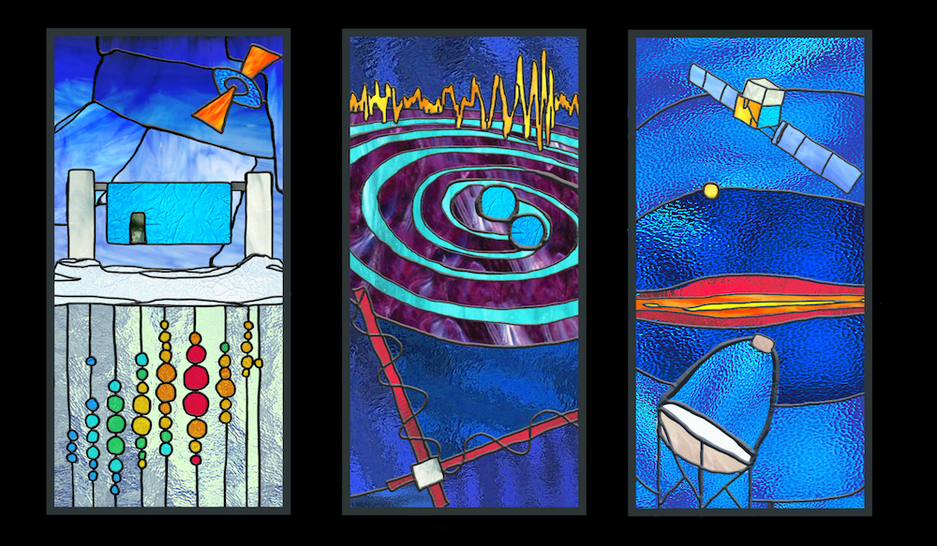
Conclusions and Outlook
IceCube continues to improve characterization of the diffuse astrophysical neutrino flux in terms of spectral shape, total flux, isotropy, and flavor ratio
Evidence for a single blazar (TXS 0506+056) as the first identified source of the neutrinos (and therefore the first identified extragalactic cosmic-ray source)
It can only explain 1% of the total diffuse neutrino flux
There must be at least 10² additional neutrino sources, and likely multiple source classes
These could be a subset of the known gamma-ray sources, however
No identified subset(s) of LAT selected blazars can explain the total diffuse neutrino flux
A population of gamma-dim (distant or occluded) blazars could explain the neutrino flux
Recently launched IceCube Upgrade will install 7 new strings and improve detector calibration, enabling better angular resolution for future and archival neutrinos
Proposed IceCube Gen 2 will enable high rate of high-energy neutrino detections in order to detect and understand the neutrino sources and source classes
Notes:
Additional interesting source classes: supernovae, radio galaxies
Non-detection of neutrinos in coincidence with gravitational waves or fast radio bursts

Slide 42
additional slides

Slide 43
The redshift of TXS 0506+056
Paiano et al., ApJL 854:L32 (2018)
Notes:
Figure 2. Normalized spectrum of the BL Lac object TXS0506+056 (see also Figure 1). Three weak (EW ∼ 0.1 Å) emission lines are detected and identified as [O II]3727Å, [O III] 5007 Å, and [N II] 6583 Å at redshift z=0.3365. Absorption features due to interstellar medium are labeled as DIB and IS. The spectral region affected by telluric absorption, indicated by ⊕, were corrected.
Figure from source at https://arxiv.org/abs/1802.01939
Luminosity distance: 1.8 Gpc
Light travel time: 3.8 Gyr
Uncertainty: 0.0010

Slide 44
Updated neutrino-blazar correlation search: classes
IceCube, PoS (ICRC 2019) 916
arXiv:1908.08458
Source counts from each category in 3FHL catalog
(Northern sources, declination > -5°, included in IceCube correlation analysis)
Notes:
Figure 1: (Left) Partition of the blazars from the 3FHL catalog into different categories. The numbers show the frequency of the respective type (numbers in brackets only take Northern heimisphere sources, δ > −5◦ into account).
Figure from source at https://arxiv.org/abs/1908.08458

Slide 45
Many dim sources, or few bright sources?
Steady or Transient?
Astro 2020: Ackermann et al, “Astrophysics uniquely enabled by observations of high-energy cosmic neutrinos” (1903.04334)
Notes:
Left: Comparison of the diffuse neutrino emission (solid magenta band) to the effective local density and luminosity of extragalactic neutrino source populations. We indicate several candidate populations (⭐) by the required neutrino luminosity to account for the full diffuse flux [17] (see also [25]). The lower (upper) edge of the band assumes rapid (no) redshift evolution. The dark-blue-shaded region indicates IceCube’s discovery potential of the closest source of the population(E2φνμ+ν ̄μ ≃10−12TeV/cm2/sintheNorthernHemisphere[26]).Right:The same comparison for transient neutrino sources parametrized by their local density rate and bolometric energy [27]. The discovery potential of the closest source is based on 10 years of livetime (E2Fνμ+ν ̄μ ≃0.1GeV/cm2intheNorthernHemisphere[28]).
10^6 * 10^39 = 10^45
10^-3 * 10^48 = 10^45
Magenta band has slope -1

Slide 46
Padovani et al. and Garrappa et al.

Slide 47
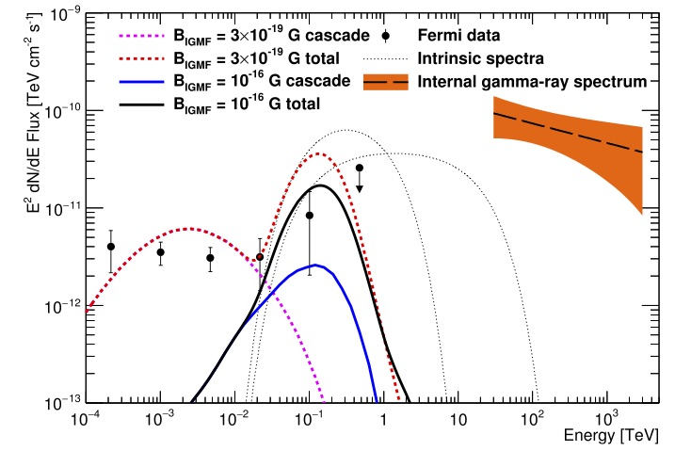
TXS 0506+056 neutrino flare without gamma flare: gammas reprocessed within source?
Halzen+,
ApJL 874:L9 (2019)
Notes:
Figure 1. Observed cascade and total spectra for our model with EH=20 TeV and BIGMF=10−16 G (thick solid lines), and for EH=1 TeV and BIGMF=3×10−19 G (thick dashed lines), along with the Fermi observations and internal pionic gamma-rays associated with the 2014 neutrino outburst. The low- energy cutoff is EL=100 GeV for both cases. The intrinsic spectra (thin dashed lines) for the two cutoff energies are given by Equation (6) and represent emission from the source after internal reprocessing but before attenuation on the EBL.

Slide 48
Self-consistent model of extragalactic neutrino flux from evolving blazar population
TXS 0506+056 is distant (z=0.3)
Typical (including nearby) gamma-ray blazars are not bright in neutrinos
How to reconcile gamma and neutrino observations?
Possible with rapid positive (increasing with z) evolution, at least as (1+z)⁵ for z< 1
Neronov & Semikoz, 1811.06356
Notes:
“Rapid evolution of neutrino emitting blazars could be explained by the fact that only high luminosity blazars hosting radiatively efficient accretion flows are efficient neutrino sources.”

Slide 49
VERITAS TXS

Slide 50
Normalization and flux for TXS, 9.5 yr and 110 day
Number of events
Box vs. gaussian durations
Integrated flux compared to all-sky flux
Same for NGC 1068
SS 433 IC ULs, MGRO 1908 / HAWC 1908

Slide 51
MAGIC, 2018 TXS modeling

Slide 52
New Upgrade hierarchy sketch

Slide 53
New: 10-year generic point source search
IceCube,
PoS (ICRC 2019)851
1908.05993
Population analysis (search for excess of weak sources): 4 𝜎 pre-trial, 3.3 𝜎 post-trial, for 4 sources each with p<0.01 in source list search: NGC 1068 and 3 blazars(TXS 0506+056, PKS 1424+240, GB6 J1542+6129)
Excluding TS 0506+056: 2.25 𝜎 post-trials
Notes:
Southern population analysis: p=0.36 post-trials, for 5 of the 13 tested sources
Figure from source at https://arxiv.org/abs/1908.05993

Slide 54
Energy PDF for IceCube-170922A

Slide 55
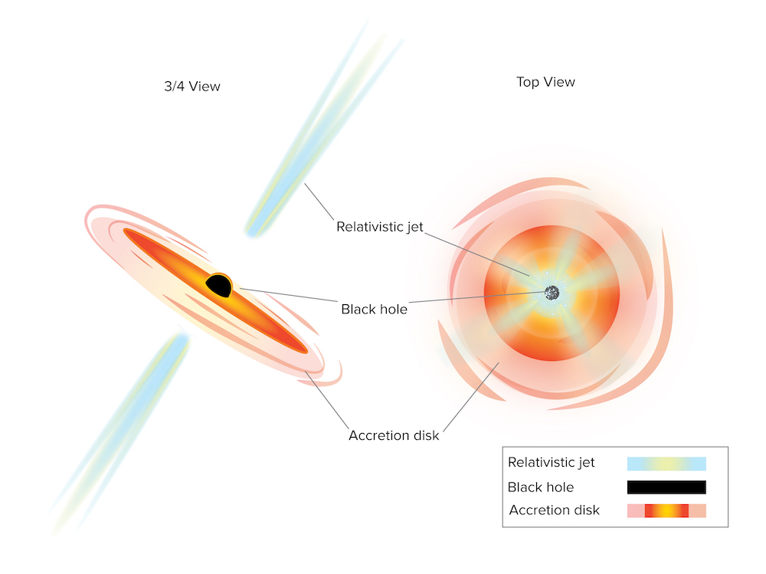
Active galactic nuclei and blazars

Slide 56
Why TXS?
Luminosity?
Hardening?
Fluctuation (Eddington bias)?

Slide 57
Eddington bias

Slide 58
Point sources with cascades

Slide 59
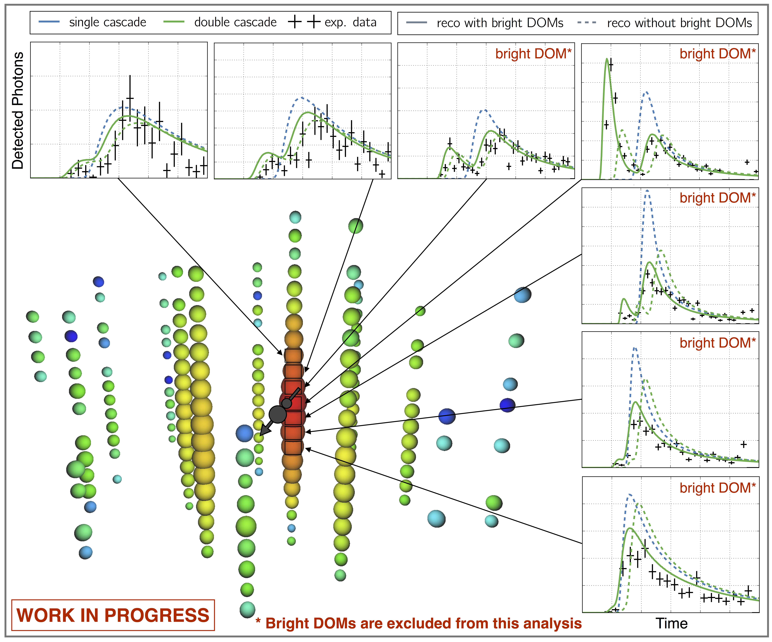
Astrophysical tau neutrinos?
Event 1
Event 2
Possible signal: astrophysical tau neutrinos
Background expectation: ~0.7 event (signal expectation: ~1.4 event)
Notes:
“background” includes astrophysical single cascades?
Event #1: L = 16 m, E1 = 1.2 PeV, E2 = 0.6 PeV
Event #2: L = 17 m, E1 = 9 TeV, E2 = 80 TeV
explain asymmetric energy difference cut
add tau vs. muon energy loss
add rebuttal concerning prompt background
Detailed study of waveforms and background probability in progress

Slide 60
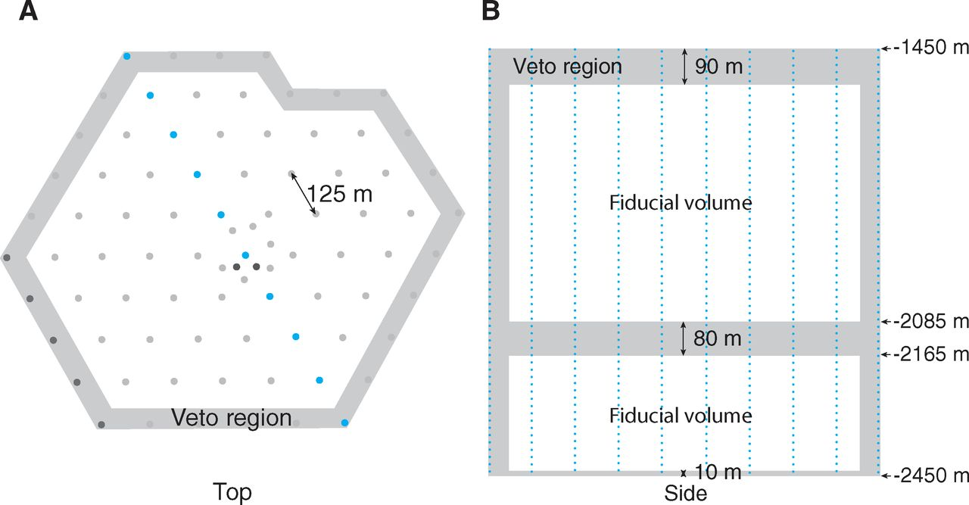
A veto technique for starting events
Science 342 (2013) 947
Atmospheric muons (dominant background) always start outside the detector
Neutrino-induced muons sometimes start inside the detector
Atmospheric neutrinos are accompanied by atmospheric muons: vetoed
Notes:
Fig. 1. Drawing of the IceCube array. Results are from the complete pictured detector for 2011 to 2012 and from a partial detector missing the dark gray strings in the bottom left corner for the 2010 to 2011 season. (A and B) The side view (B) shows a cross section of the detector indicated in the top view (A) in blue. Events producing first light in the veto region (shaded area) were discarded as entering tracks (usually from cosmic ray muons entering the detector). Most background events are nearly ver- tical, requiring a thick veto cap at the top of the detector. The shaded region in the middle contains ice of high dust concentration (24). Because of the high degree of light absorption in this region, near horizontal events could have entered here without being tagged at the sides of the detector without a dedicated tagging region.

Slide 61
The neutrinos are not produced predominantly by gamma-ray bursts
IceCube,
ApJ 843:112 (2017)
excluded region
allowed
No GRB correlation with five years of muon neutrino track events
Conclusion: <1% of astrophysical neutrino flux is produced by GRBs
Non-detection disfavors GRBs as the primary source of UHE cosmic rays
Notes:
Figure 8. Excluded regions for a given CL of the generic double broken power law neutrino spectrum as a function of first break energy εb and per-flavor quasi-diffuse flux normalization Φ0 derived from the presented results combined with previous Northern Hemisphere track (Aartsen et al. 2015d) and all-sky cascade (Aartsen et al. 2016a) searches. Models of neutrino production assuming GRBs are the sole source of the measured UHECR flux either by neutron escape (Ahlers et al. 2011) or proton escape (Waxman & Bahcall 1997) from the relativistic fireball are provided for reference.
Implications for GRB as CR sources?
1172 satellite-detected GRBs

Slide 62
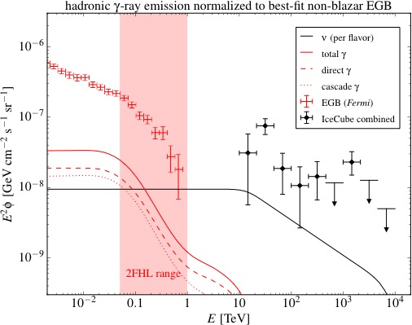
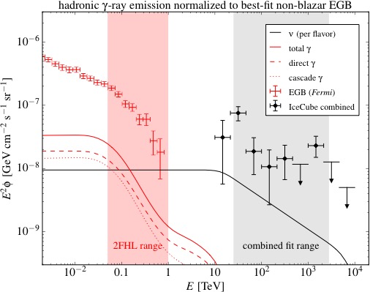
The neutrinos are not produced predominantly by star-forming galaxies
Maximum non-blazar gamma-ray spectrum
Corresponding neutrino spectrum
Bechtol, Ahlers, Di Mauro, Ajello, Vandenbroucke, ApJ 836:47 (2017)
Notes:
The total measured extragalactic background (EGB) spectrum is shown (red points), along with the maximum component that could be due to star-forming galaxies (red line). The corresponding calculated neutrino spectrum is shown as a black line, compared to the IceCube measured spectrum. Star-forming galaxies can explain some but not most of the IceCube signal. [9]
8 star-forming galaxies detected by LAT:
non-starbursts MW, M31 (Andromeda), LMC, SMC
starbursts M82, NGC 253, NGC 2146, Arp 220

Slide 63
Searches for neutrinos from fast radio bursts
No significant correlation (time & direction) found in Northern or Southern hemisphere
1 year: S. Fahey, A. Kheirandish, J. Vandenbroucke, D. Xu, ApJ 845 (2017) 1, 14
6 year: IceCube, ApJ 857 (2018) 117
Additional analyses underway

Slide 64
The multi-messenger triad
Gravitational waves – gamma rays
  Yes (discovery): binary neutron star merger (GW 170817)
Neutrinos – gamma rays
  Yes (evidence): blazar (TXS 0506+056)
Neutrinos – gravitational waves?
  ??

Slide 65
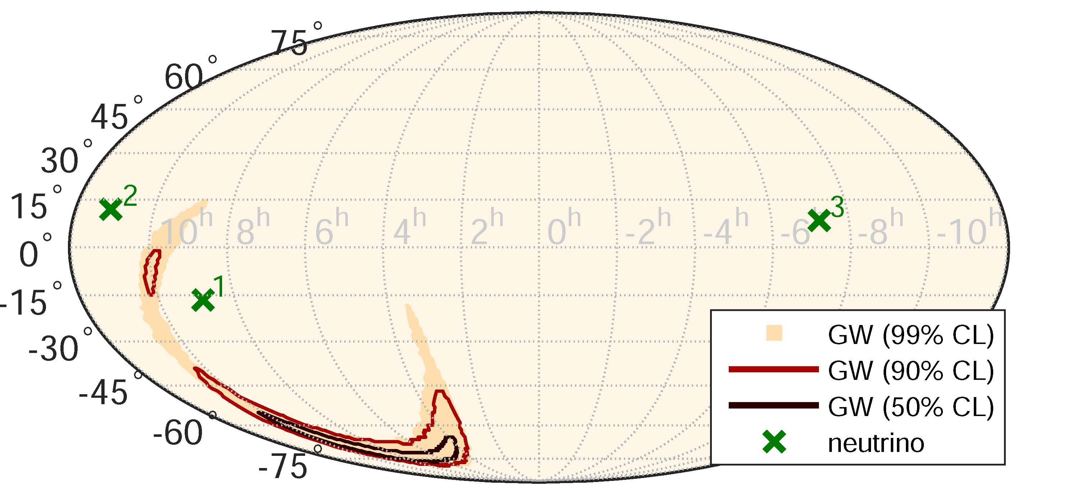
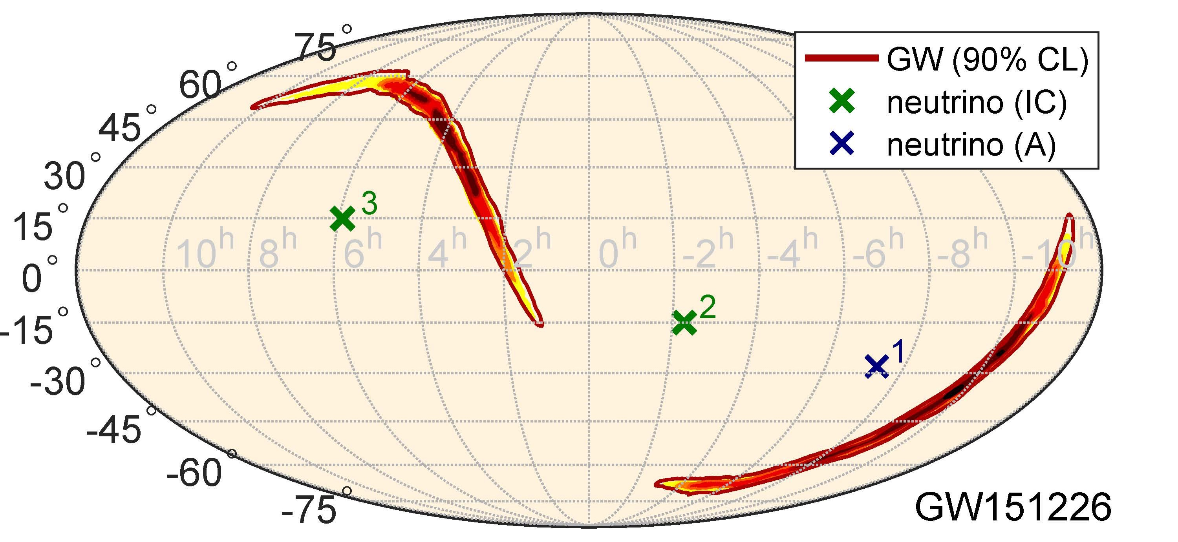
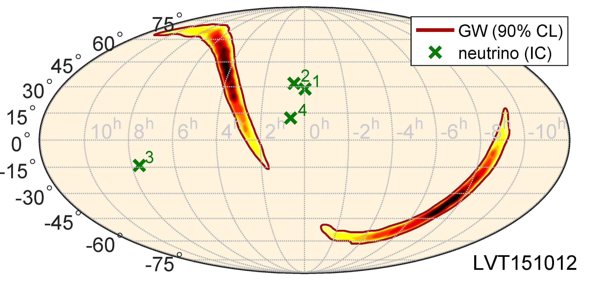
Neutrinos from gravitational wave sources?
Binary black hole (GW150914)
Binary neutron star (GW 170817)
PRD 93, 122010 (2016)
ApJL 850:L35 (2017)
PRD 96, 022005 (2017)
IceCube, ANTARES, Auger, LIGO/VIRGO
Notes:
Figure 1. Localizations and sensitive sky areas at the time of the GW event in equatorial coordinates: GW 90% credible-level localization (red contour; Abbott et al. 2017b), direction of NGC 4993 (black plus symbol; Coulter et al. 2017b), directions of IceCube’s and ANTARESʼs neutrino candidates within 500 s of the merger (green crosses and blue diamonds, respectively), ANTARESʼs horizon separating down-going (north of horizon) and up-going (south of horizon) neutrino directions (dashed blue line), and Auger’s fields of view for Earth-skimming (darker blue) and down-going (lighter blue) directions. IceCube’s up-going and down-going directions are on the northern and southern hemispheres, respectively. The zenith angle of the source at the detection time of the merger was 73.°8 for ANTARES, 66°.6 for IceCube, and 91°.9 for Auger.
150914: 3 neutrinos
Neutrino search: ±500 seconds
GW150914: 3 IceCube, 0 ANTARES, muon energies 0.33-175 TeV
GW151226: 2 IceCube, 1 ANTARES, muon energies 6.3-158 TeV
LVT151012: 4 IceCube, 0 ANTARES, muon energies 0.35-13.7 TeV
Top 1 panel:
FIG. 1. GW skymap in equatorial coordinates, showing the reconstructed probability density contours of the GW event at 50%, 90% and 99% CL, and the reconstructed directions of high- energy neutrino candidates detected by IceCube (crosses) during a `500 s time window around the GW event. The neutrino directional uncertainties are < 1° and are not shown. GW shading indicates the reconstructed probability density of the GW event, darker regions corresponding to higher probability. Neutrino numbers refer to the first column of Table I.
Bottom 2 panels:
FIG. 1. GW skymap for GW151226 (top) and LVT151012 (bottom), and the reconstructed directions for high-energy neutrino candidates detected by IceCube (green crosses) and Antares (blue cross) within ±500 s around the GW signals. The maps are in equatorial coordinates. The GW skymap shows the reconstructed probability density contours of the GW event 90% CL. GW shading indicates the reconstructed probability density of the GW event, darker regions corresponding to higher probability. The neutrino directional un- certainties are below 1◦ for most of the candidates, and in any case too small to be shown. Neutrino event numbers refer to the first column of Table I.

Slide 66
Realtime search for neutrinos from gravitational wave sources during LIGO/Virgo O3
GW Event | Classification | Distance (Mpc) | Coincident IceCube neutrinos
S190408an | BBH (>99%) | 1473 ± 358 | 0
S190412m | BBH (>99%) | 812 ± 194 | 0
S190421ar | BBH (97%) | 1628 ± 535 | 0
S190425z | BNS (>99%) | 156 ± 41 | 0
S190426c | BNS (49%) | 377 ± 100 | 0
S190503bf | BBH (96%) | 421 ± 105 | 0
S190510g | Terrestrial (58%) | 227 ± 92 | 0
S190512at | BBH (99%) | 1388 ± 322 | 0
S190513bm | BBH (94%) | 1987 ± 501 | 0
S190517h | BBH (98%) | 2950 ± 1038 | 1 (p = 0.094)
S190519bj | BBH (96%) | 3154 ± 791 | 0
S190521g | BBH (97%) | 3931 ± 953 | 0
S190521r | BBH (99%) | 1136 ± 279 | 0
13 new gravitational waves, announced publicly within a few hours, since April 1!
Notes:
S190405ar was retracted
S190421ar: 3% Terrestrial (1e-8 Hz FAR)
S190426c: 24% MassGap, 14% terrestrial, 13% NSBH
S190510g: 42% BNS
S190513bm: 5% MassGap
S190517h: 2% MassGap
S190518bb: 25% Terrestrial (1e-8 Hz FAR)
S190518bb was retracted (28±15 Mpc BNS 75%)
S190519bj: 4% Terrestrial
S190521g 3% Terrestrial
1e-8 Hz * 3e7 sec = 0.3 false alarms per year = 1 false alarm every 3-4 months
2 total retractions
Using distances from LAL Inference when available, otherwise bayestar
As of May 21:
51 days / 13 GW = one every 4 days
13/51 days

Slide 67
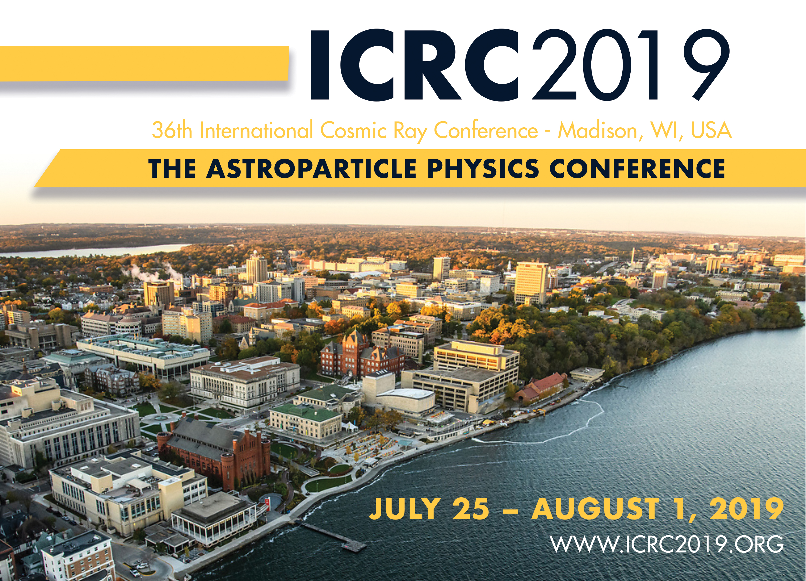

Slide 68




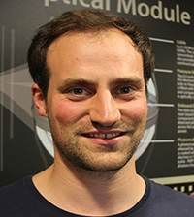







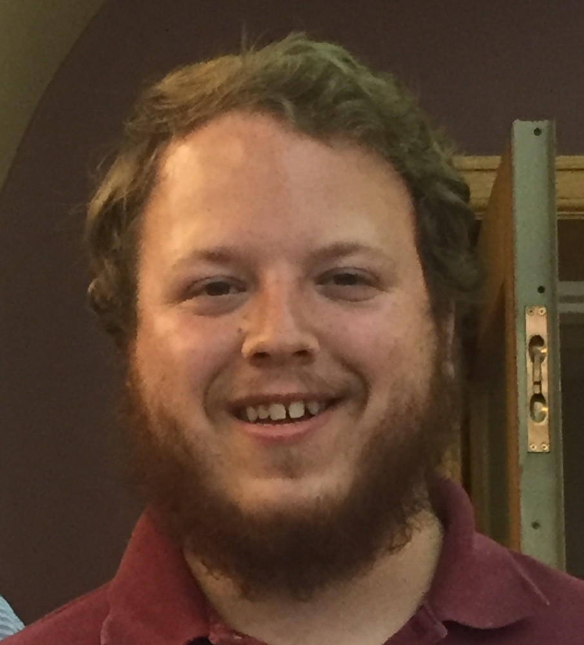
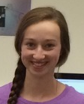










Thank you to my collaborators, current and former group members, and supporting organizations

Slide 69
Search for neutrinos in coincidence with gravitational waves from binary black hole mergers (multi-messenger astrophysics without electromagnetic messengers!)
GW150914
PRD 93, 122010 (2016)
PRD 96, 022005 (2017)
ANTARES, IceCube, LIGO/VIRGO partnership
Notes:
150914: 3 neutrinos
Neutrino search: ±500 seconds
GW150914: 3 IceCube, 0 ANTARES, muon energies 0.33-175 TeV
GW151226: 2 IceCube, 1 ANTARES, muon energies 6.3-158 TeV
LVT151012: 4 IceCube, 0 ANTARES, muon energies 0.35-13.7 TeV
Top 1 panel:
FIG. 1. GW skymap in equatorial coordinates, showing the reconstructed probability density contours of the GW event at 50%, 90% and 99% CL, and the reconstructed directions of high- energy neutrino candidates detected by IceCube (crosses) during a `500 s time window around the GW event. The neutrino directional uncertainties are < 1° and are not shown. GW shading indicates the reconstructed probability density of the GW event, darker regions corresponding to higher probability. Neutrino numbers refer to the first column of Table I.
Bottom 2 panels:
FIG. 1. GW skymap for GW151226 (top) and LVT151012 (bottom), and the reconstructed directions for high-energy neutrino candidates detected by IceCube (green crosses) and Antares (blue cross) within ±500 s around the GW signals. The maps are in equatorial coordinates. The GW skymap shows the reconstructed probability density contours of the GW event 90% CL. GW shading indicates the reconstructed probability density of the GW event, darker regions corresponding to higher probability. The neutrino directional un- certainties are below 1◦ for most of the candidates, and in any case too small to be shown. Neutrino event numbers refer to the first column of Table I.

Slide 70
Astrophysical neutrino flavor ratio
Muon damped
Standard 𝜋 production
Neutron decay
at Earth
0:1:0
IceCube, ApJ 809:98 (2015)
IceCube, PRL 114, 171102 (2015)
0:0:1
1:0:0
Production of purely electron neutrinos at the source (from neutron decay) rejected at 3.6 σ significance
“Muon damped”: muons lose energy to synchrotron radiation within/near source
With future data, the neutrino flavor ratio can constrain magnetic field amplitude at source of astrophysical neutrinos / cosmic rays
Notes:
Figure 8. Profile likelihood scan of the flavor composition at Earth. Each point in the triangle corresponds to a ratio ne: nm: nt as measured on Earth, the individual contributions are read off the three sides of the triangle. The best-fit composition is marked with “×”; 68% and 95% confidence regions are indicated. The ratios corresponding to three flavor composition scenarios at the sources of the neutrinos, computed using the oscillation parameters in Gonzalez-Garcia et al. (2014, inverted hierarchy), are marked by the square (0:1:0), circle (1:2:0), and triangle (1:0:0), respectively. The best-fit composition obtained in an earlier IceCube analysis of the flavor composition (Aartsen et al. 2015b) is marked with a “+.”
Muon damped scenario: muons lose energy before decaying. Only nu-mu produced at same time as muon (in pion decay) escape at high energy. Nu-e from muon decay are at much lower energy.
source classes with muon damped possibility?
Standard: pi -> µ numu -> e nue numu numu
Neutron decay: n -> p e nuebar
Muon damped: µ loses a lot of energy, so you only get numu

Slide 71
Search for Galactic neutrino sources with HAWC + IceCube
Joshua Wood (IceCube)
TeVPA 2017
analysis in progress
Search for cumulative neutrino emission from 20 Galactic HAWC sources
If 100% hadronic, expected total emission is greater than stacked IC sensitivity
If no detection, will constrain hadronic fraction of HAWC emission to be <100%

Slide 72
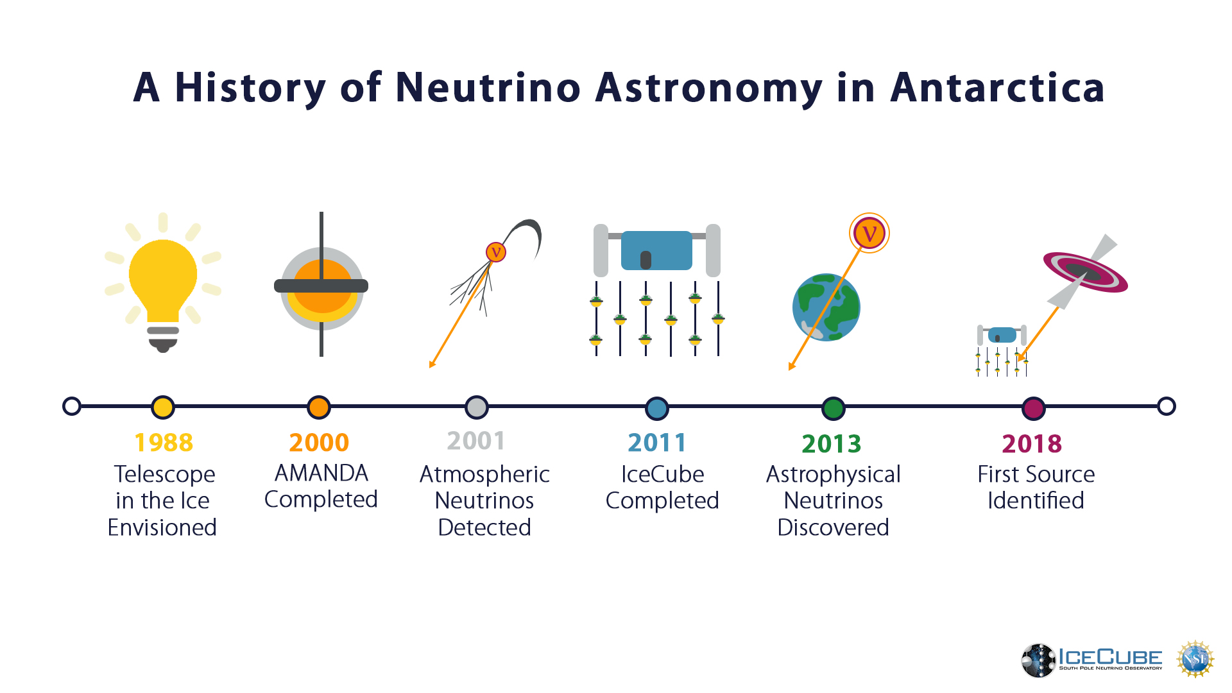

Slide 73
MAGIC: first detection of very-high-energy gamma rays from the direction of a high-energy neutrino
Observed the blazar with 12 hours of observations over ~10 days after 170922A
Detected up to 400 GeV

Slide 74
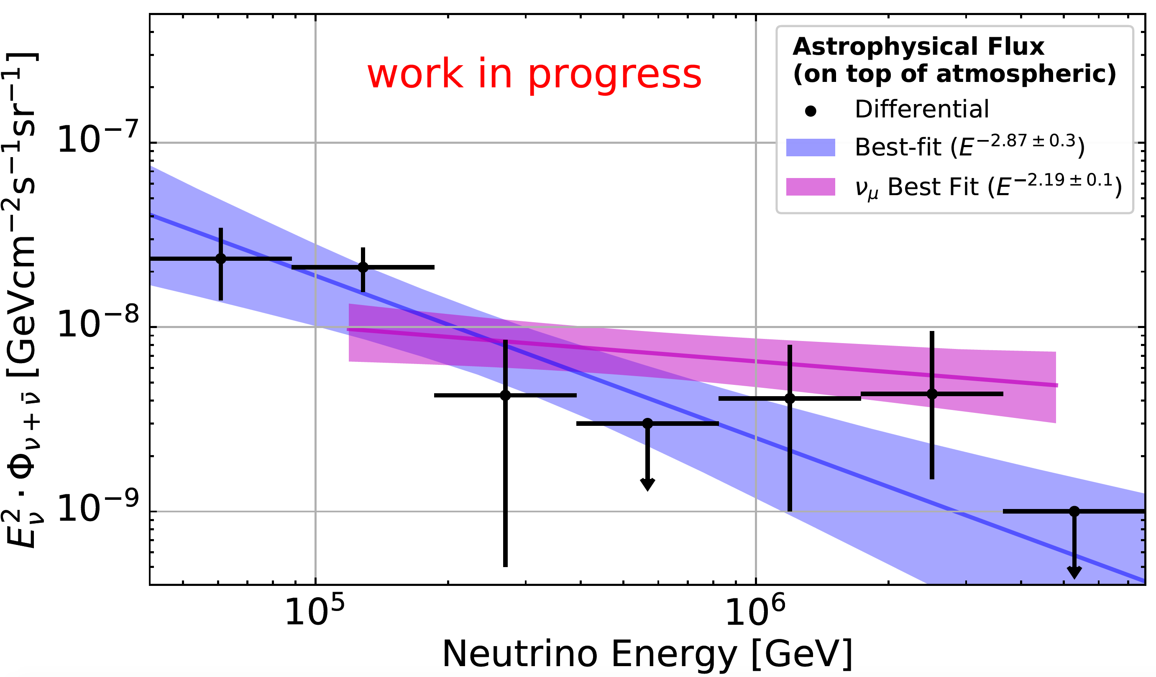
Characterizing the diffuse astrophysical neutrino spectrum
Notes:
Figure 5: Arrival directions of the events in galactic coordinates. Shower-like events are marked with a + and those containing tracks with a ×. The new events of table 1 are shown in black. Colors show the test statistics (TS) for the point-source clustering test at each location. No significant clustering was found.
4 year was 6.5 sigma
2 of the 82 events have coincident muons
~8 sigma: Nancy Wandkowsky @ TeVPA 2017 (6 years of data)
More detials on 6 year analysis:
1710.01191 (ICRC)
TODO: add details of each dataset
Back of envelope discrepancy test: (2.19-2.87) = 0.68 ± 0.316 so 2.2 sigma

Slide 75
Characterizing the diffuse astrophysical neutrino spectrum
90% CL
IceCube, ApJ 833:3 (2016)
Analysis | Index | Normalization @ 100 TeV | Significance (σ) | Energy range
HESE 6 yr | 2.92 ± 0.3 | 2.46 ± 0.8 | 8 | 60 TeV to 3 PeV
Northern tracks 6 yr | 2.19 ± 0.10 | 1.01 +0.26 -0.23 | 6.7 | 119 TeV to 4.8 PeV
Cascades 4 yr | 2.48 ± 0.08 | 1.57 +0.23 -0.22 | 4.7 (2 year) | 10 TeV to 1 PeV
Global fit | 2.50 ± 0.09 | 2.2 ± 0.4 |  | 25 TeV to 2.8 PeV
Notes:
Figure 13. Results of different IceCube analyses measuring the astrophysical flux parameters Fastro and gastro. The contour lines show the 90% CL. The result of this analysis (IC tracks, 6yr) is shown by the red solid contour line. The contour obtained by the previous measurement using through-going muons (Aartsen et al. 2015c) (IC tracks, 2yr) is the red dashed line. In addition, the results for the most recent analysis of starting events (Kopper et al. 2015) (IC HESE, 4yr), the complementary cascade channel (Niederhausen et al. 2015) (IC cascades) and an analysis combining different IceCube results (IC combined, Aartsen et al. 2015f) are shown. The result of this analysis (red, solid) and IC combined are incompatible at 3.3 sigma (two-sided significance).
Event counts:
54 HESE 4 yr
172 Cascades 2 yr
HESE energy range is *deposited*
Global fit published numbers are sum of flavors, and others are per flavor, so global fit norm and its errors have here been divided by 3
All assume 1:1:1
Tension between
TODO: add significance for global fit
TODO: double check energy range for 6 yr HESE (0.06-3 PeV is for 4 yr)
TODO: significance of cascade 4 year result
TODO: add HESE 7.5 yr
HESE 7.5: index 2.87 +0.3 -0.2; norm 1.86 +0.8 -0.6

Slide 76
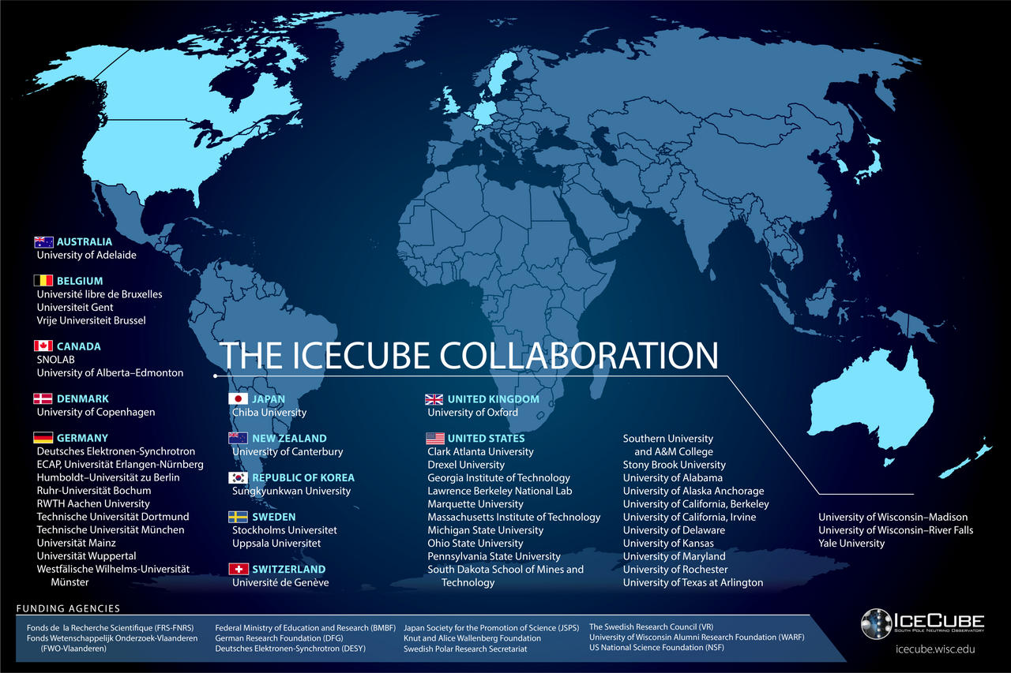
12 countries, 4 continents, 49 institutions, 300 scientists

Slide 77
Chance coincidence disfavored with 3 𝜎 significance
There are many flaring gamma-ray objects on the sky: was the neutrino coincident by chance?
Calculate using 2257 extragalactic LAT detected sources above 1 GeV
This was the 10th public alert
An additional 41 IceCube events from 2010 to 2016 would have generated alerts if the alert program were running
Simulate realizations of the alert events and compare to the gamma-ray sky to calculate chance coincidence probability

Slide 78
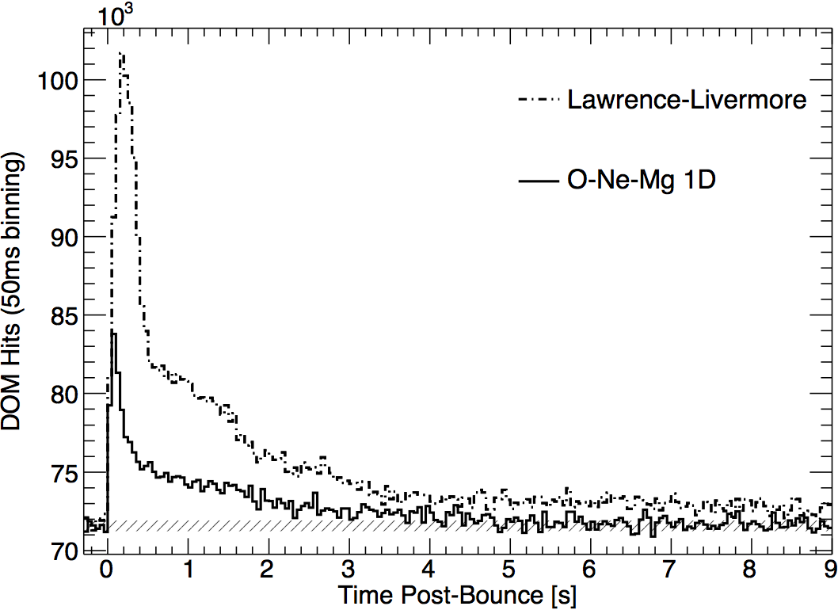
MeV neutrino detection with IceCube, for supernovae and other transients
IceCube, A&A 535, A109 (2011)
Above 1.8 MeV, electron anti neutrinos induce inverse beta decay, producing a neutron and a positron
Positron produces Cherenkov photons before annihilating
Each photomultiplier tube can detect a local sphere of neutrino interactions
A burst of MeV neutrinos is detectable as a cumulative rise in the photon rates across many photomultiplier tubes
Useful for detecting supernova neutrinos and other MeV neutrino bursts
Notes:
Fig. 10. Expected rate distribution at 10 kpc distance for the Lawrence- Livermore model (dashed line) and O-Ne-Mg model by Hüdepohl et al. (2010) with the full set of neutrino opacities (solid line). The 1 σ-band corresponding to measured detector noise (hatched area) has a width of about ±330 counts.

Slide 79
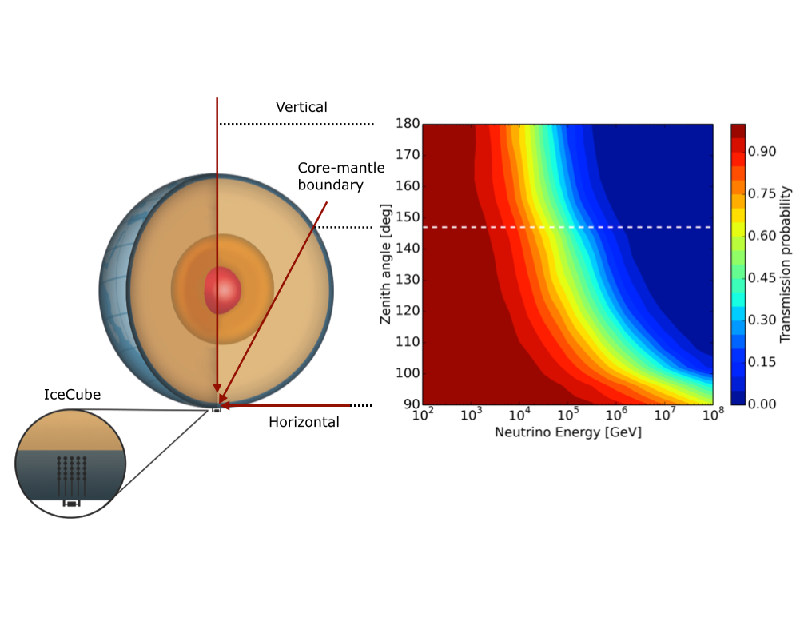
Measurement of neutrino-nucleon cross section using Earth absorption
IceCube, Nature 551 (2017) 596
Notes:
Figure 2 | Neutrino absorption in the Earth. a, Neutrino absorption is observed by measuring how the neutrino energy spectrum changes with the zenith angle. High-energy neutrinos transiting deep through the Earth are absorbed, whereas low-energy neutrinos are not. Neutrinos from just below the horizon provide a nearly absorption-free baseline at all relevant energies. b, Standard model prediction for the transmission probability of neutrinos through the Earth as a function of energy and zenith angle. Neutral-current interactions, which occur about 1/3 of the time, are included. When a neutral-current interaction occurs, a neutrino is replaced with one of lower energy. The horizontal white dotted line shows the trajectory (and zenith angle) of a neutrino that just passes through the core–mantle boundary.

Slide 80
Measurement of neutrino-nucleon cross section using Earth absorption
IceCube, Nature 551 (2017) 596
Notes:
Figure 1 | Neutrino cross-section measurements. Measured neutrino charged-current interaction cross-sections σν, divided by the neutrino energy Eν, from accelerator experiments are shown, along with error bars showing their combined 1σ statistical and systematic uncertainty, from ref. 1 and from this work. The blue and green lines are the standard model predictions for muon neutrinos νμ and antineutrinos νμ, respectively, with the uncertainties on the deep-inelastic cross-sections shown by the shaded bands³. The red line corresponds to the expected mixture of νμ and νμ in the IceCube sample. The black line shows our result, assuming that the charged- and neutral-current cross-sections vary in proportion, and that the ratio between the actual cross-section and the standard model prediction does not depend on energy. The pink band shows the total 1σ (statistical plus systematic) uncertainty. The cross-section increases linearly with energy up to about 3 TeV (log(3,000) = 3.48), after which this increase is moderated and the cross-section becomes roughly proportional to (Eν)^{0.3} owing to the finite W± and Z⁰ masses.
Why are neutrino and antineutrino cross sections different?
“In this x range, there are more quarks than antiquarks, so the interaction cross-section of the antineutrino is about half that of the neutrino.”
How does weighted combination work?
0.35 and 0.65
2/(1/0.35 + 1/0.65) = 0.45
(0.35+0.65)/2 = 0.5
Up +2/3
Down -1/3
Neutron = udd
Proton = uud
H: 1p
H2: 2p = 4u + 2d
show derivation of ratio

Slide 81

New (June 2018):
Astrophysical neutrino flavor ratio with 7.5 yr HESE events

Slide 82

New (June 2018): High-energy starting events (7.5 years)
Discovery of two double-cascade events

Slide 83

Angular resolution (tracks from muon neutrinos)
IceCube, ApJ 835:151 (2017)
Muon neutrino median angular resolution ($°$)
Notes:
Figure 2. IceCube median angular resolution vs. neutrino energy for numu + numubar calculated from Monte Carlo simulation for the IC86 sample described in Section 2.2. Through-going tracks (solid black) are shown together with starting tracks (dashed black; see Section 2.3). Moreover, the median kinematic angle of the secondary muon in CC neutrino interactions is shown (dotted black line).
from seven-year point source paper

Slide 84
Search for diffuse Galactic neutrinos
Model:
Gaggero et al. PRL 2017, 119
Galactic neutrinos are expected from both diffuse emission and discrete sources
Measurements of diffuse 1-500 TeV Galactic diffuse neutrinos will complement 0.2-300 GeV gamma-ray measurements
See also IceCube, ApJ 849:67 (2017): <14% of diffuse 𝜈 flux is Galactic
Notes:
Figure 2. Upper limits at the 90% confidence level on the three-flavor (1:1:1 flavor ratio assumption) neutrino flux from the Galaxy with respect to KRA model predictions and the measured astrophysical flux. Fluxes are integrated over the whole sky for uniform comparison. The IceCube 7-year upper limit for the KRA-γ (50 PeV) model test for the ps-template method is shown in red. The energy range of validity is from 1 to 500 TeV. This range is calculated by finding the low- and high-energy thresholds where removing simulated signal events outside these values decreases the sensitivity by 5% each. The ANTARES limit in blue (Adrián-Martínez et al. 2016a), directly applicable in the Galactic center region (-40° < l < 40° and -3° < b < 3°), has been scaled to represent an all-sky integrated flux for comparison. Due to ANTARES being located in the northern hemisphere, it has a relatively high sensitivity in the southern sky near the Galactic center region using muon neutrinos. The range of predictions for all the KRA models (Gaggero et al. 2015) is shown as the gray band, with the top of that band representing the KRA-γ (50 PeV) model. The model by Ingelman & Thunman (Ingelman & Thunman 1996) is shown in purple. For comparison, measurements of the all- sky diffuse flux are shown: a differential unfolding (black points) and a power- law unfolding (yellow band) of combined IceCube data sets from Aartsen et al. (2015a), as well as a measurement based only on northern sky muon data (green band), from Aartsen et al. (2016).
Models: D. Gaggero et al. ApJL 815, L25 (2015)
From Gaggero et al:
“Following (Gaggero et al. 2014), the starting point is a conventional propagation setup characterized by δ = 0.5, compatible with a Kraichnan spectrum of the interstellar turbulence within the quasi-linear theory framework. We will refer to this setup as the “KRA model” (see also Evoli et al. 2011).”
delta is defined by D(rho) propto (rho/rho_0)^delta
Paper abstract:
The origins of high-energy astrophysical neutrinos remain a mystery despite extensive searches for their sources. We present constraints from seven years of IceCube Neutrino Observatory muon data on the neutrino flux coming from the Galactic plane. This flux is expected from cosmic-ray interactions with the interstellar medium or near localized sources. Two methods were developed to test for a spatially extended flux from the entire plane, both of which are maximum likelihood fits but with different signal and background modeling techniques. We consider three templates for Galactic neutrino emission based primarily on gamma-ray observations and models that cover a wide range of possibilities. Based on these templates and in the benchmark case of an unbroken E-2.5 power-law energy spectrum, we set 90% confidence level upper limits, constraining the possible Galactic contribution to the diffuse neutrino flux to be relatively small, less than 14% of the flux reported in Aartsen et al. above 1 TeV. A stacking method is also used to test catalogs of known high-energy Galactic gamma-ray sources.

Slide 85

Search for diffuse Galactic neutrinos
IceCube, ApJ 849:67 (2017)
<14% of diffuse 𝜈 flux is Galactic
Galactic neutrinos are expected from both diffuse emission and discrete sources
Measurements of diffuse 1-500 TeV Galactic diffuse neutrinos will complement 0.2-300 GeV gamma-ray measurements
Notes:
Figure 2. Upper limits at the 90% confidence level on the three-flavor (1:1:1 flavor ratio assumption) neutrino flux from the Galaxy with respect to KRA model predictions and the measured astrophysical flux. Fluxes are integrated over the whole sky for uniform comparison. The IceCube 7-year upper limit for the KRA-γ (50 PeV) model test for the ps-template method is shown in red. The energy range of validity is from 1 to 500 TeV. This range is calculated by finding the low- and high-energy thresholds where removing simulated signal events outside these values decreases the sensitivity by 5% each. The ANTARES limit in blue (Adrián-Martínez et al. 2016a), directly applicable in the Galactic center region (-40° < l < 40° and -3° < b < 3°), has been scaled to represent an all-sky integrated flux for comparison. Due to ANTARES being located in the northern hemisphere, it has a relatively high sensitivity in the southern sky near the Galactic center region using muon neutrinos. The range of predictions for all the KRA models (Gaggero et al. 2015) is shown as the gray band, with the top of that band representing the KRA-γ (50 PeV) model. The model by Ingelman & Thunman (Ingelman & Thunman 1996) is shown in purple. For comparison, measurements of the all- sky diffuse flux are shown: a differential unfolding (black points) and a power- law unfolding (yellow band) of combined IceCube data sets from Aartsen et al. (2015a), as well as a measurement based only on northern sky muon data (green band), from Aartsen et al. (2016).
Models: D. Gaggero et al. ApJL 815, L25 (2015)
From Gaggero et al:
“Following (Gaggero et al. 2014), the starting point is a conventional propagation setup characterized by δ = 0.5, compatible with a Kraichnan spectrum of the interstellar turbulence within the quasi-linear theory framework. We will refer to this setup as the “KRA model” (see also Evoli et al. 2011).”
delta is defined by D(rho) propto (rho/rho_0)^delta
Paper abstract:
The origins of high-energy astrophysical neutrinos remain a mystery despite extensive searches for their sources. We present constraints from seven years of IceCube Neutrino Observatory muon data on the neutrino flux coming from the Galactic plane. This flux is expected from cosmic-ray interactions with the interstellar medium or near localized sources. Two methods were developed to test for a spatially extended flux from the entire plane, both of which are maximum likelihood fits but with different signal and background modeling techniques. We consider three templates for Galactic neutrino emission based primarily on gamma-ray observations and models that cover a wide range of possibilities. Based on these templates and in the benchmark case of an unbroken E-2.5 power-law energy spectrum, we set 90% confidence level upper limits, constraining the possible Galactic contribution to the diffuse neutrino flux to be relatively small, less than 14% of the flux reported in Aartsen et al. above 1 TeV. A stacking method is also used to test catalogs of known high-energy Galactic gamma-ray sources.

Slide 86

Search for Galactic neutrinos: diffuse spatial template
IceCube, ApJ 849:67 (2017)
Based on Fermi 𝜋⁰ template combined with IceCube effective area and angular resolution (forward folding)
Also tested models from Ingelman & Thunman (1996), Gaggero et al. 2015
Notes:
Figure 2. Upper limits at the 90% confidence level on the three-flavor (1:1:1 flavor ratio assumption) neutrino flux from the Galaxy with respect to KRA model predictions and the measured astrophysical flux. Fluxes are integrated over the whole sky for uniform comparison. The IceCube 7-year upper limit for the KRA-γ (50 PeV) model test for the ps-template method is shown in red. The energy range of validity is from 1 to 500 TeV. This range is calculated by finding the low- and high-energy thresholds where removing simulated signal events outside these values decreases the sensitivity by 5% each. The ANTARES limit in blue (Adrián-Martínez et al. 2016a), directly applicable in the Galactic center region (-40° < l < 40° and -3° < b < 3°), has been scaled to represent an all-sky integrated flux for comparison. Due to ANTARES being located in the northern hemisphere, it has a relatively high sensitivity in the southern sky near the Galactic center region using muon neutrinos. The range of predictions for all the KRA models (Gaggero et al. 2015) is shown as the gray band, with the top of that band representing the KRA-γ (50 PeV) model. The model by Ingelman & Thunman (Ingelman & Thunman 1996) is shown in purple. For comparison, measurements of the all- sky diffuse flux are shown: a differential unfolding (black points) and a power- law unfolding (yellow band) of combined IceCube data sets from Aartsen et al. (2015a), as well as a measurement based only on northern sky muon data (green band), from Aartsen et al. (2016).
Models: D. Gaggero et al. ApJL 815, L25 (2015)
From Gaggero et al:
“Following (Gaggero et al. 2014), the starting point is a conventional propagation setup characterized by δ = 0.5, compatible with a Kraichnan spectrum of the interstellar turbulence within the quasi-linear theory framework. We will refer to this setup as the “KRA model” (see also Evoli et al. 2011).”
delta is defined by D(rho) propto (rho/rho_0)^delta
Paper abstract:
The origins of high-energy astrophysical neutrinos remain a mystery despite extensive searches for their sources. We present constraints from seven years of IceCube Neutrino Observatory muon data on the neutrino flux coming from the Galactic plane. This flux is expected from cosmic-ray interactions with the interstellar medium or near localized sources. Two methods were developed to test for a spatially extended flux from the entire plane, both of which are maximum likelihood fits but with different signal and background modeling techniques. We consider three templates for Galactic neutrino emission based primarily on gamma-ray observations and models that cover a wide range of possibilities. Based on these templates and in the benchmark case of an unbroken E-2.5 power-law energy spectrum, we set 90% confidence level upper limits, constraining the possible Galactic contribution to the diffuse neutrino flux to be relatively small, less than 14% of the flux reported in Aartsen et al. above 1 TeV. A stacking method is also used to test catalogs of known high-energy Galactic gamma-ray sources.

Slide 87
Validation of direction reconstruction with Moon shadow
IceCube, PRD 89 (2014) 102004
Expect these ~40 TeV (median) primary cosmic rays to be deflected by ~0.1°in geomagnetic field
Notes:
FIG. 8 (color online). Contour plot of the value of ns in the ðΔα; ΔδÞ coordinate system for on-source region of the IC59 data set.
Muon direction within 0.1° of CR direction for multi-TeV muons
CR energy threshold: several TeV needed in order to produce a muon that survives to IceCube depth
Central 68% energy range of primaries: 10-200 TeV
Muon energies in sample: 2 TeV at ground level, 200 GeV at detector
Modeling: deflection = 1.9° * Z / E[TeV]

Slide 88
No cosmogenic (GZK) neutrino detection: starting to constrain EHE cosmic rays as protons
IceCube, PRL 117, 241101 (2016)
proton models
Non-detection in 6 years of data (including 3 years of IC86)
Beginning to disfavor proton UHECR models in favor of heavier composition
If composition is heavy (high Z), it will be difficult to detect UHECR sources
Notes:
FIG. 4. All-flavor-sum neutrino flux quasi-differential 90% CL upper limit on one energy decade E−1 flux windows (solid line). The limits are derived using a log-likelihood ratio method. The median null observation limit (sensitivity) is also shown (dashed line). Cosmogenic-neutrino model predictions (assuming primary protons) are shown for comparison: Kotera et al. [53], Ahlers et al. [42], and an astrophysical neutrino model from Murase et al. [56]. Model-independent differential limits on one energy decade E−1 flux from Auger [45] and ANITA-II [88] with appropriate normalization are also shown. A model-dependent upper limit on an unbroken E−2 power-law flux from the current analysis (E2ν φ < 9.2 × 10−9 GeV=cm2 s sr) is shown for refer- ence (dotted line).

Slide 89

No correlation detected between astrophysical neutrinos and ultra-high-energy cosmic rays
● neutrino cascades
◆ through tracks
◆ HESE tracks
★ Auger
★ TA
E> ~5e19 eV
IceCube, Auger, TA,
JCAP01 (2016) 037
Expect Galactic magnetic fields to deflect 10²⁰ eV protons by ~3°
If UHECR composition is heavy (e.g. iron), magnetic fields likely deflect them too much to detect discrete sources or correlation with neutrino directions
Notes:
Figure 7. Maps in Equatorial and Galactic coordinates showing the arrival directions of the IceCube cascades (black dots) and tracks (diamonds), as well as those of the UHECRs detected by the Pierre Auger Observatory (magenta stars) and Telescope Array (orange stars). The circles around the showers indicate angular errors. The black diamonds are the HESE tracks while the blue diamonds stand for the tracks from the through-going muon sample. The blue curve indicates the Super-Galactic plane.
Auger: 231 events above 5.2e19 eV from 10 years (2004 to 2014)
TA: 87 events above 5.7e19 eV from 6 years (2008 to 2014)

Slide 90
IceCube Digital Optical Module
IceCube, J. Inst. 12 (2017) P03012
IceCube, NIM A 618 (2010) 139-152
10 inch diameter PMT digitized within the module
FADC: 40 MHz, 256 samples (6400 ns), no dead time, gain of 23
ATWD (Analog Transient Waveform Digitizer) ASIC: 3-channel (each with different gain), 300 MHz, 128 analog samples (427 ns) stored in buffer and digitized upon request, dead time 32-88 µs depending on number of channels digitized
Notes:
3 ATWD gains: 16, 2, 0.25

Slide 91


Slide 92

Detector down time < 1%
IceCube, J Inst 12 (2017) P03012
Notes:
Figure 50. Detector performance breakdown by run period. Clean uptime indicates pristine, full-detector data; “good uptime” includes partial-detector runs that are otherwise healthy; and “excluded uptime” indicates runs that are declared unusable for analysis.

Slide 93


Slide 94

Particle accelerators
(Hillas plot)
Ahlers et al., from IceCube, Adv. Space Res. review (2017)
Notes:
Fig. 1. A modern adaption of the so-called ‘‘Hillas plot”. It displays upper
limits on the reachable CR energy dependent on the size of the
acceleration region and magnetic field strength. The red lines indicate
the upper limits due to the loss of confinement in the acceleration region
for CRs at the knee, ankle, and the Greisen-Zatsepin-Kuzmin (GZK) cutoff
(Greisen, 1966; Zatsepin and Kuzmin, 1966). The dotted gray line
corresponds to a second upper limit that arises from synchrotron losses in
the sources and interactions in the cosmic photon background. Figure
taken from Ahlers et al. (2010a). (For interpretation of the references
to color in this figure legend, the reader is referred to the web version of
this article.)
LHC magnets:
8 Tesla

Slide 95
Search for neutrinos from fast radio bursts in 1 year of data
S. Fahey, A. Kheirandish, J. Vandenbroucke, D. Xu, ApJ 845 (2017) 1, 14
No FRB has an IceCube event coincident in direction
(within estimated 99% error radius) and time on one day time scale

Slide 96
Search for neutrinos from fast radio bursts in 6 years of data
IceCube, 1712.06277

Slide 97
Search for neutrinos from fast radio bursts in 6 years of data
IceCube, 1712.06277

Slide 98
Search for astrophysical tau neutrinos
IceCube, 1710.01191 (ICRC 2017)
Notes:
Figure 4: All-flavor ratio measurement using the ternary PID (this work) on the six-year HESE data sample. The best-fit is marked with ’×’. The solid and dashed lines show the 68% and 95% contours, respectively. Compositions expected at Earth are marked for three different source scenarios. The gray lines show the previously published 68% and 95% contours [13].

Slide 99
Tau neutrino upper limit from three years of 86-string data
IceCube, PRD 93, 022001 (2016)
Reached >2 orders of magnitude lower energy than previous (Pierre Auger) tau neutrino searches
Notes:
FIG. 10. Neutrino flux upper limits and models as a function of the primary neutrino energy. The thick red curve is the ντ differential upper limit derived from this analysis, including systematic and statistical errors. In computing the differential upper limit, values of the flux limit were calculated for each energy decade with a sliding energy window of 0.1 decade. The thick black error bars depict the all-flavor astrophysical neutrino flux observed by IceCube [2]. The thick dashed line is the differential upper limit derived from a search for extremely high energy events which has found the first two PeV cascade events in IceCube [42,47]. The blue dotted line is the Auger differential upper limit from ντ-induced air showers [27]. The orange dashed line is the Waxman-Bahcall upper bound which uses the UHECR flux to set a bound on astrophysical neutrino production [48]. The dash-dotted line (magenta) represents the prompt neutrino flux predicted from GRBs; prompt in this context means in time with the gamma rays [49]. The dash-dot-dot line (grey) indicates the neutrino flux predicted from the cores of active galaxies [50]. The thin dash- triple-dot line (red) shows the neutrino flux predicted from star
galaxies, which are rich in supernovae [51].

Slide 100
Complementarity of IceCube and ANTARES/KM3NeT
IceCube,
1712.06277
South
North

Slide 101
Search for neutrinos in coincidence with gravitational waves from binary neutron star merger (kilonova)
ANTARES, IceCube, Auger, LIGO/Virgo, ApJL 850:L35 (2017)

Slide 102

An up-going muon neutrino track depositing several PeV
ATel #7856
Track with <1°angular resolution
Discovered in six-year (2009-2015) astrophysical muon neutrino analysis
Deposited 2.6 PeV (June 11, 2014)
Neutrino energy likely several times larger
Less than 0.01% chance of being atmospheric background
Notes:
Image from http://icecube.wisc.edu/news/view/346
We observed a muon event with an energy of multiple PeV originating from a neutrino interaction in the vicinity of the IceCube detector. IceCube is a cubic-kilometer neutrino detector installed in the ice at the geographic South Pole mostly sensitive to neutrinos in the TeV-PeV energy range. The event is the highest-energy event in a search for a diffuse flux of astrophysical muon neutrinos using IceCube data recorded between May 2009 and May 2015. It was detected on June 11th 2014 (56819.20444852863 MJD) and deposited a total energy of 2.6 +/- 0.3 PeV within the instrumented volume of IceCube, which is also a lower bound on the muon and neutrino energy. The reconstructed direction of the event (J2000.0) is R.A.: 110.34 deg and Decl.: 11.48 deg. For simulated events with the same topology, 99% of them are reconstructed better than 1 deg and 50% better than 0.27 deg. The probability of this event being of atmospheric origin is less than 0.01%. The IceCube contact persons for this event are Leif Raedel (RWTH Aachen University, raedel@physik.rwth-aachen.de) and Sebastian Schoenen (RWTH Aachen University, schoenen@physik.rwth-aachen.de)

Slide 103
Complementarity of IceCube and ANTARES/KM3NeT
IceCube, 1712.06277

Slide 104

IceCube measurement of neutrino-nucleon cross section using Earth absorption
IceCube, Nature 551 (2017) 596
Notes:
Figure 3 | Cross-section data compared with Monte Carlo model predictions. Energy spectrum of the data (black points) and the best-fit results (red curve) with the cross-sections fixed to 0.2 (green) and 3.0 (blue) times that predicted by the standard model for events with zenith angles between 110° and 180°, where absorption is substantial, are shown in the top panel. The bottom panel shows the ratios of the data to the three Monte Carlo predictions. The error bars show the 1σ (statistical only) errors.

Slide 105

Two PeV events detected in two years of data
One year with 79 strings + one year with 86 strings
This analysis was optimized for extremely high energy (GZK) neutrinos
Each event is a contained neutrino-induced shower with at least 1 PeV deposited in detector (lower limit on neutrino energy)
First hint of astrophysical neutrinos (atmospheric events unlikely to produce this many events at this high energy): 2.8 σ significance
Notes:
FIG.4 (color online). The two observed events from (a) August 2011 and (b) January 2012. Each sphere represents a DOM. Colors represent the arrival times of the photons where red indicates early and blue late times. The size of the spheres is a measure for the recorded number of photoelectrons.
http://antarcticaneutrinos.blogspot.com/2013/04/bert-and-ernie-step-out.html
Bert (left), Ernie (right)

Slide 106
Evidence for astrophysical neutrinos in two years of data
Same two years of data (IC79 and IC86) as first two PeV events
Follow-up analysis using starting events to reduce energy threshold and detect both tracks and showers from full sky
26 additional events (28 total)
Inconsistent with purely atmospheric origin at 4.1 σ significance
IceCube, Science 342, 1242856 (2013)
IceCube, PRL 113, 101101 (2014)
Notes:
Science paper: 687 citations according to Google Scholar May 25 2017
13.5 events per year
How many of 54 are background?
Atm muon: 12.6 ± 5.1
Atm neutrinos: 9.0 +8.0 -2.2
So ~40% are background
Back of envelope significance: 54 on 21.6±9.5, so (54-21.6)/9.5 = 3.4 but this does not energy and direction distributions
Events 1-28 (years 1-2):
7 tracks
21 showers
Events 29-37 (year 3):
1 track
7 showers
1 coincident (background)
Events 38-54 (year 4):
6 tracks
11 showers
Total:
14 tracks
39 showers
1 coincident (background)
54 total

Slide 107
Neutrino oscillations
IceCube, PRL 120,
071801 (2018)

Slide 108
Sterile neutrino search
excluded
allowed
IceCube, PRD 95, 112002 (2017)
Notes:
Figure caption:
FIG. 9. The results of the likelihood scan performed in the analysis. The solid lines in the larger panel show the exclusion limits set in this study at 90% (dark blue) and 99% C.L. (light blue) assuming the normal neutrino (NO) mass ordering and using critical values from χ2 with 2 d.o.f. The dark (light) red dash-dotted lines represent the 90% (99%) C.L. exclusions assuming an inverted mass ordering (IO). The dashed lines show the exclusion from the Super-Kamiokande experiment [66]. The top and right panels show the projection of the likelihood on the mixing matrix elements jUμ4j2 and jUτ4j2, respectively.
Abstract:
We present a search for a light sterile neutrino using three years of atmospheric neutrino data from the DeepCore detector in the energy range of approximately 10–60 GeV. DeepCore is the low-energy subarray of the IceCube Neutrino Observatory. The standard three-neutrino paradigm can be probed by adding an additional light (Δm241 ∼ 1 eV2) sterile neutrino. Sterile neutrinos do not interact through the standard weak interaction and, therefore, cannot be directly detected. However, their mixing with the three active neutrino states leaves an imprint on the standard atmospheric neutrino oscillations for energies below 100 GeV. A search for such mixing via muon neutrino disappearance is presented here. The data are found to be consistent with the standard three-neutrino hypothesis. Therefore, we derive limits on the mixing matrix elements at the level of jUμ4j2 < 0.11 and jUτ4j2 < 0.15 (90% C.L.) for the sterile neutrino mass splitting Δm241 1⁄4 1.0 eV2.

Slide 109
Declination distribution of starting events
(four years)
Science 342 (2013) 947

Slide 110


A possible Glashow resonance event
Resonance:
E_{ν} = 6.3 PeV
Work in progress
Event not contained: identified in partially contained PeV search (PEPE)
Deposited energy: 5.9±0.18 PeV (stat only)
IceCube, 1710.01191 (ICRC)

Slide 111
An up-going muon neutrino track depositing several PeV
ATel #7856
Track with <1°angular resolution
Discovered in six-year (2009-2015) astrophysical muon neutrino analysis
Deposited 2.6 PeV (June 11, 2014)
Neutrino energy likely several times larger
Less than 0.01% chance of being atmospheric background
Notes:
Image from http://icecube.wisc.edu/news/view/346
We observed a muon event with an energy of multiple PeV originating from a neutrino interaction in the vicinity of the IceCube detector. IceCube is a cubic-kilometer neutrino detector installed in the ice at the geographic South Pole mostly sensitive to neutrinos in the TeV-PeV energy range. The event is the highest-energy event in a search for a diffuse flux of astrophysical muon neutrinos using IceCube data recorded between May 2009 and May 2015. It was detected on June 11th 2014 (56819.20444852863 MJD) and deposited a total energy of 2.6 +/- 0.3 PeV within the instrumented volume of IceCube, which is also a lower bound on the muon and neutrino energy. The reconstructed direction of the event (J2000.0) is R.A.: 110.34 deg and Decl.: 11.48 deg. For simulated events with the same topology, 99% of them are reconstructed better than 1 deg and 50% better than 0.27 deg. The probability of this event being of atmospheric origin is less than 0.01%. The IceCube contact persons for this event are Leif Raedel (RWTH Aachen University, raedel@physik.rwth-aachen.de) and Sebastian Schoenen (RWTH Aachen University, schoenen@physik.rwth-aachen.de)

