Slide 1



Searching for astrophysical neutrinos from gravitational wave sources in real time with IceCube
Justin Vandenbroucke, Raamis Hussain, Alex Pizzuto
(University of Wisconsin – Madison)
for the IceCube Collaboration
APS April Meeting, April 20, 2020

Slide 2
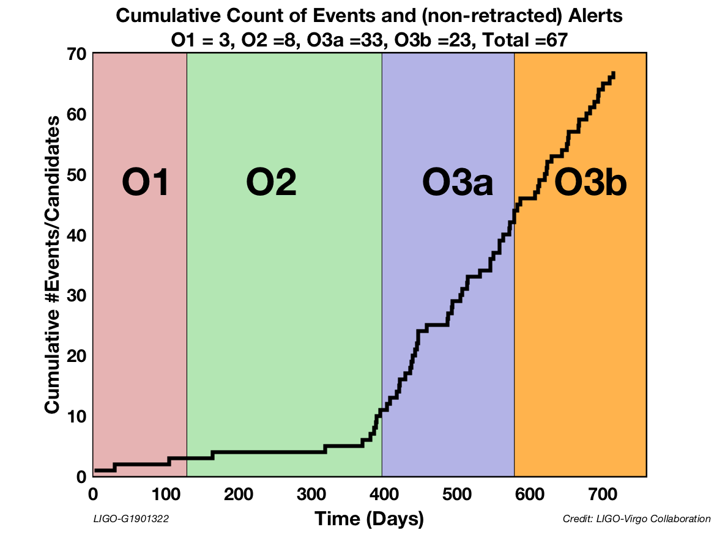
Introduction
LIGO-Virgo Collaboration (LVC) has reported a total of 67 gravitational wave candidates during the complete O1, O2, and O3 observing runs
  47 Binary black hole mergers (BBH)
  7 Binary neutron star merger (BNS)
  5 Neutron-star black hole (NSBH)
  4 Mass gap
  3 Terrestrial
  1 unclassified (coherent wave burst candidate)
Multi-messenger GW–EM and EM–neutrino signals have been discovered. How about neutrino–GW?
New paper on analysis of all 11 GW from O1 and O2 posted two weeks ago
  IceCube Collaboration, arXiv:2004.02910
Notes:
47+7+5+8 = 67
47+7+5+4+3+1
Other:
3 Ter
4 MG
1 cWB (coherent waveburst)
O1: 3 GW between Sep and Dec 2015
O2: 8 GW between Jan and Aug 2017
O3: 42+14=56 GW candidates between April 2019 and March 2020
Image from https://www.ligo.caltech.edu/system/media_files/binaries/481/original/O3_detection_count.png

Slide 3
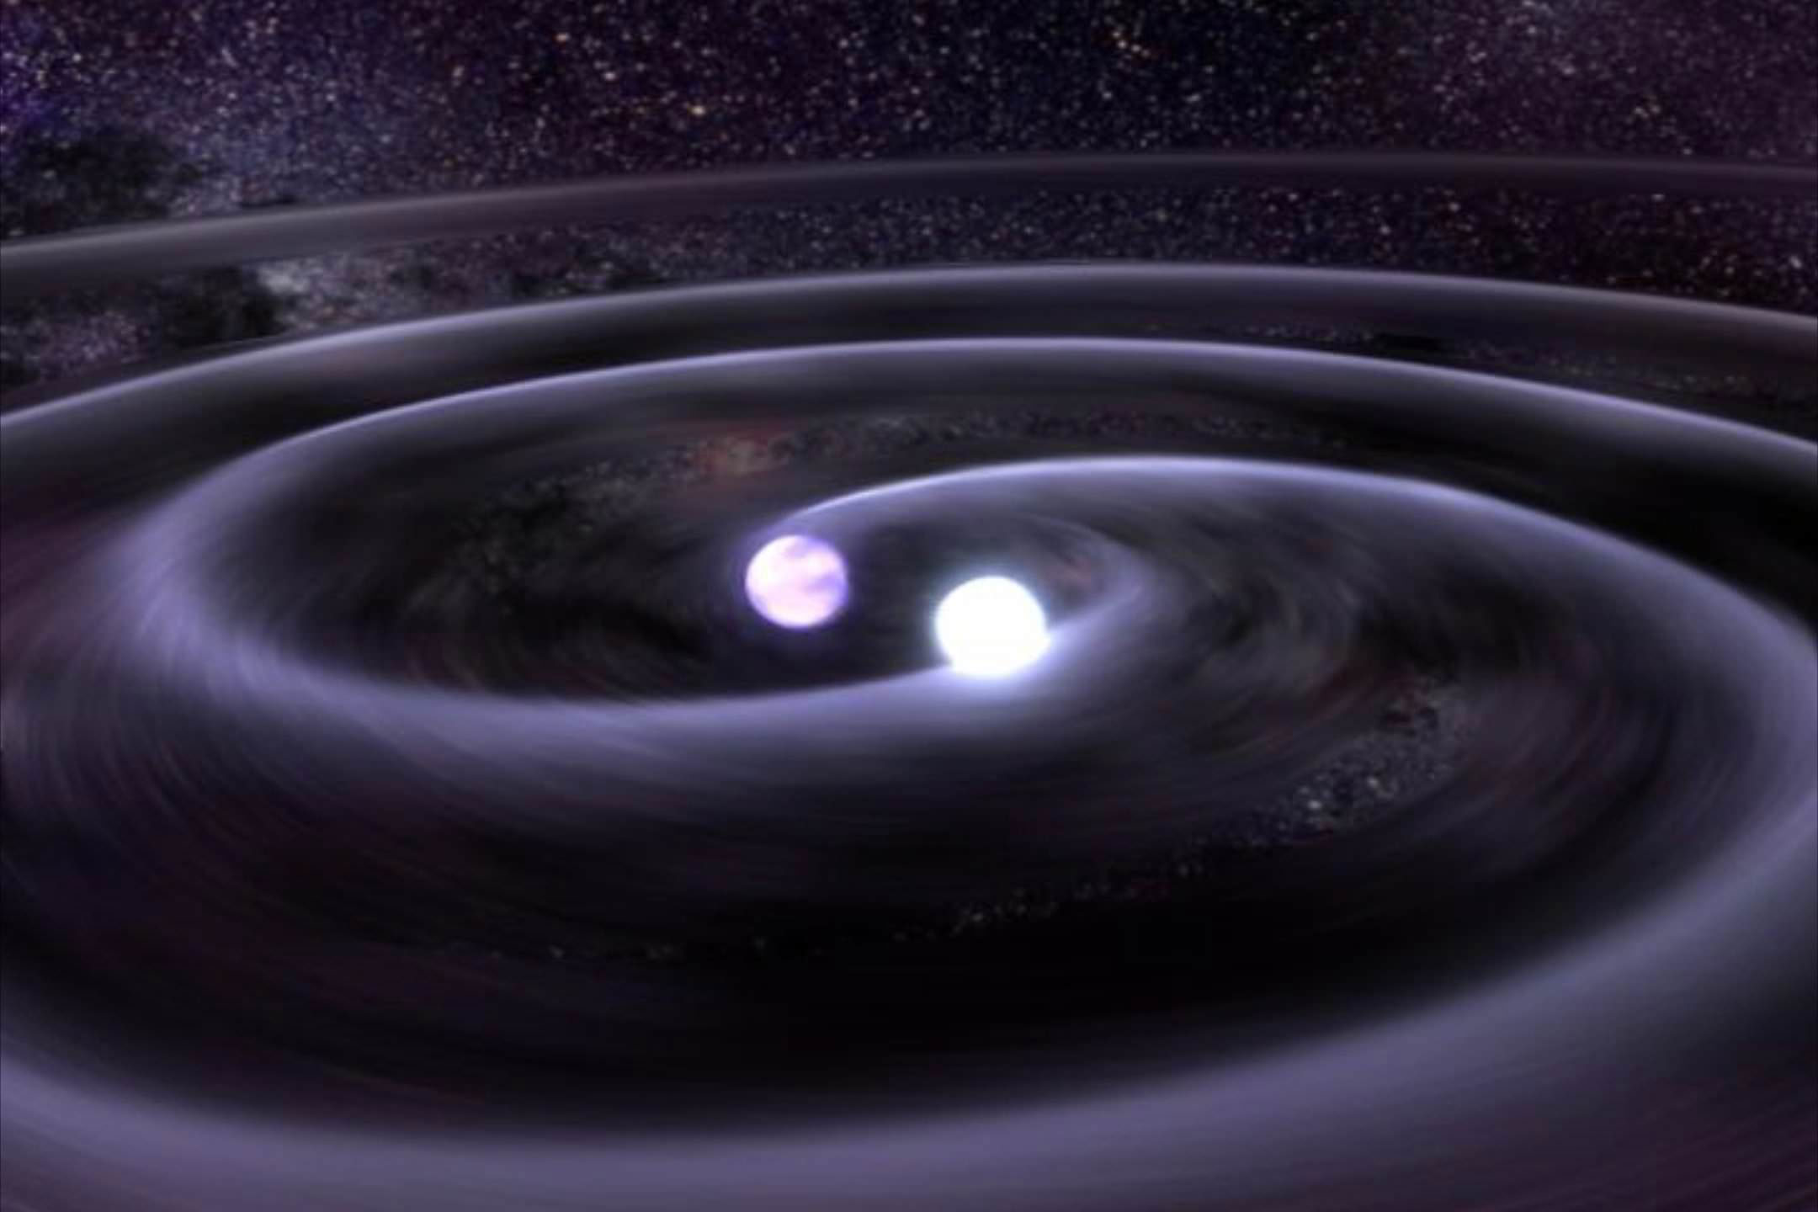
Search strategy
IceCube has completed searches for neutrino emission from GW events detected by LVC during O1, O2, and O3 observing runs
Searched ±500 second time window with respect to GW event time, using localization sky maps provided by LVC
Two analyses described in IceCube Collaboration, arXiv:2004.02910 (O1 & O2 results)
  Maximum likelihood search for arbitrary transients (focus of this talk)
  Bayesian search with astrophysical priors
In O3, ran in real time in order to quickly report coincident neutrino candidates with ~10² times smaller localization sky area than GW

Slide 4
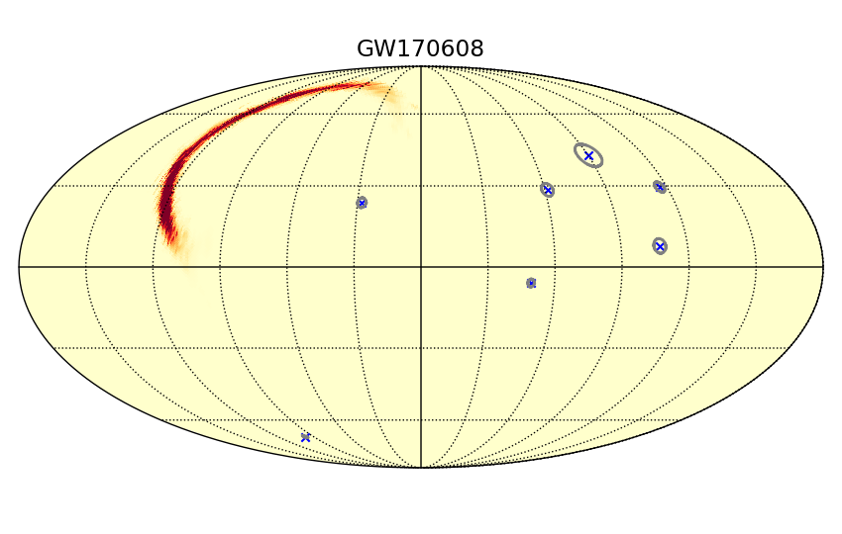
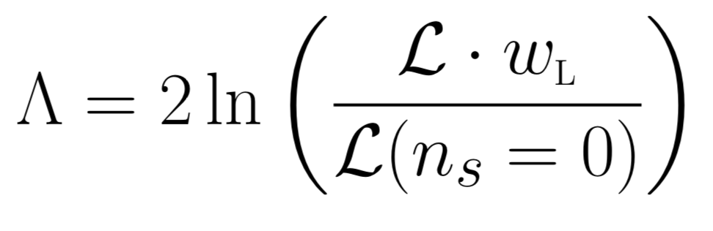
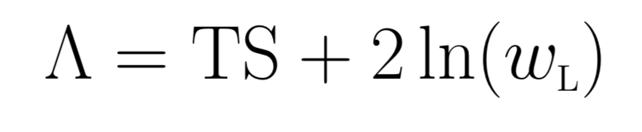
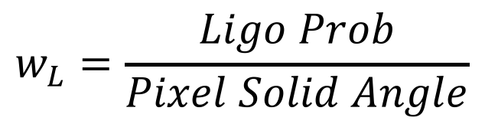
Spatial Prior
Incorporate the gravitational wave probability skymap as a spatial prior in the likelihood at every point in the sky:
$$w_{L}=\frac{Ligo Prob}{Pixel Solid Angle}$$
Example: GW170608
Notes:
Median GW localization (90% containment): 700-800 sq deg
Median GFU localization (90% containment): 5-6 sq deg
Ratio = 150

Slide 5
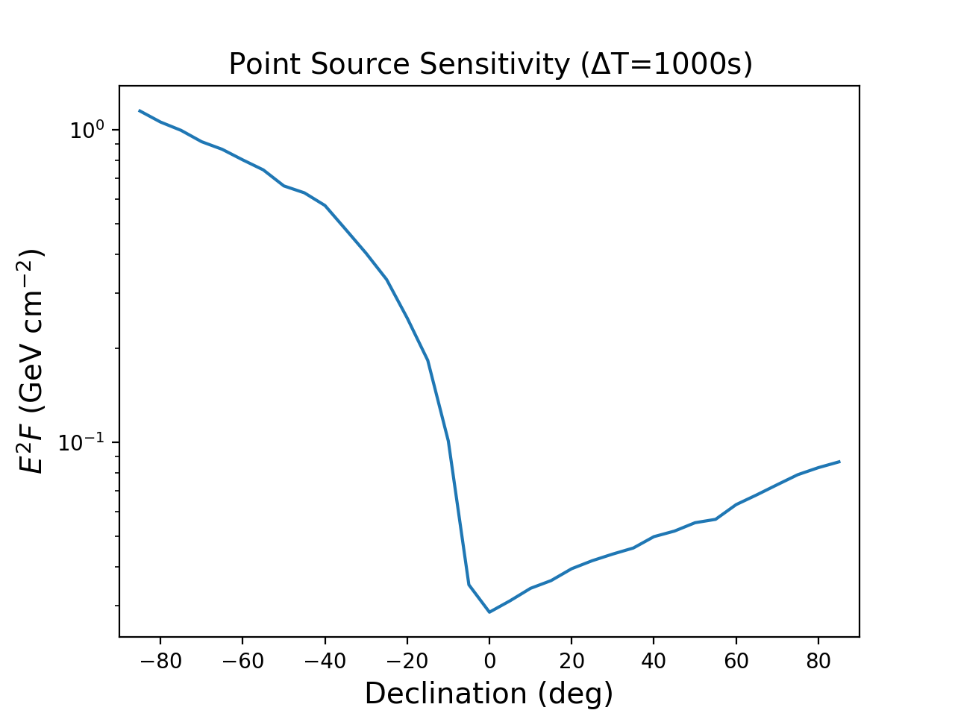
Neutrino flux sensitivity vs. declination
IceCube operates with >99% livetime
Sensitivity to the full sky (4π), with better sensitivity in Northern sky than Southern sky
Analysis accounts for full GW sky map, angular uncertainty of IceCube events, background rate of event selection, and neutrino effective area dependence on declination
IceCube Collaboration,
arXiv:2004.02910

Slide 6
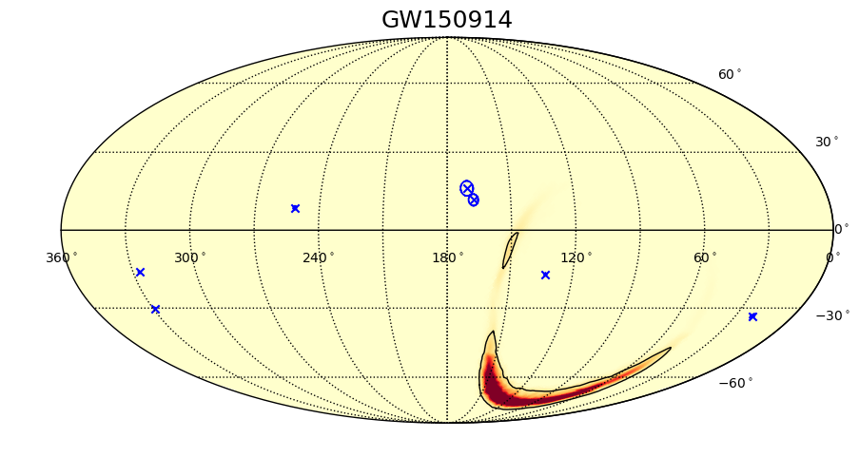
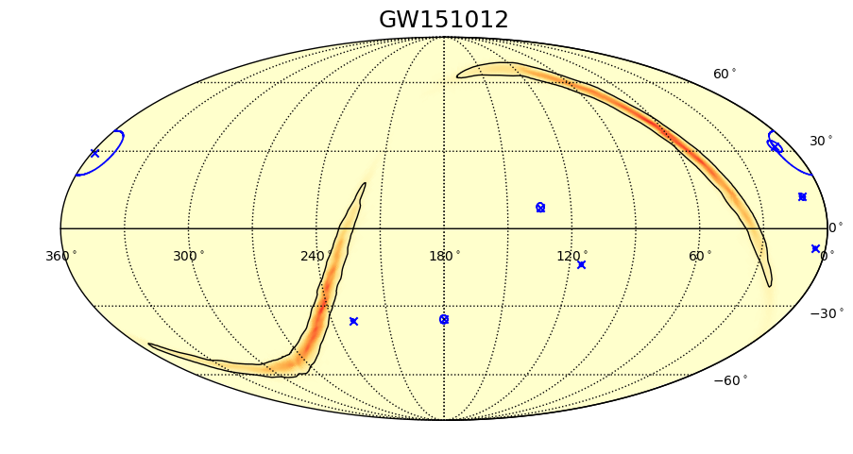
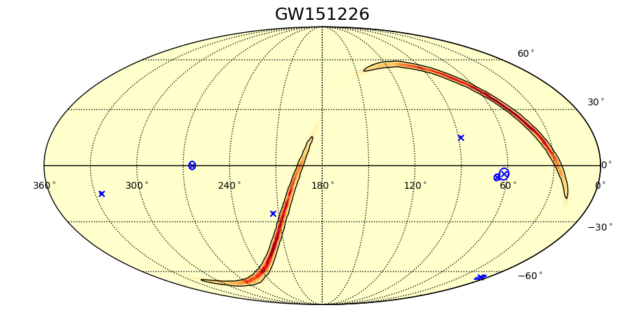
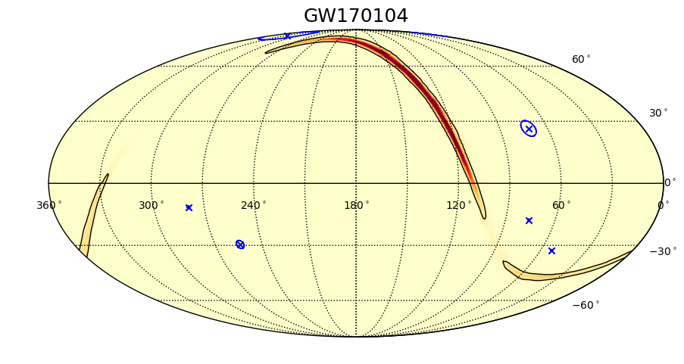
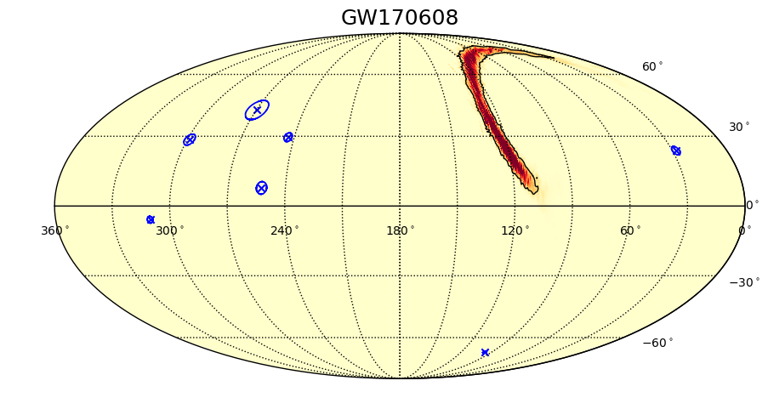
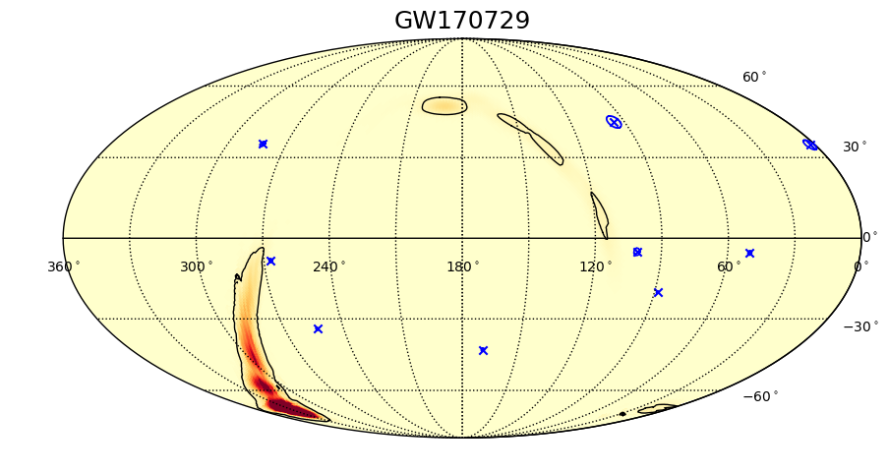
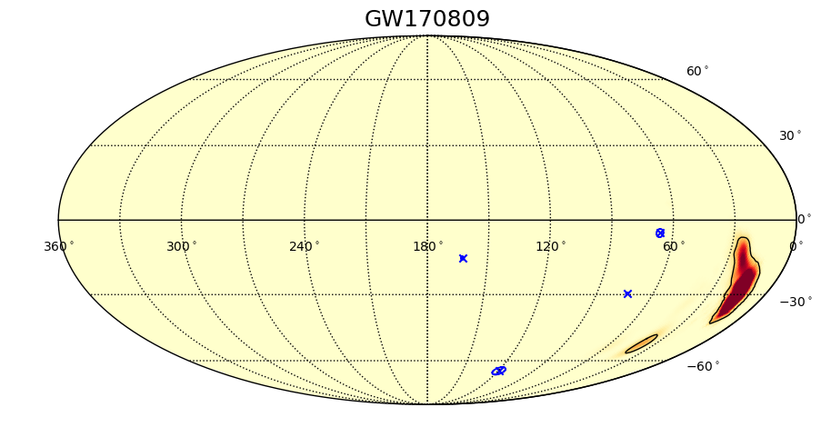
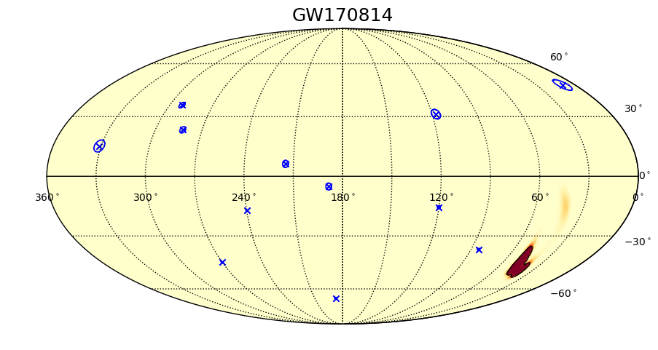
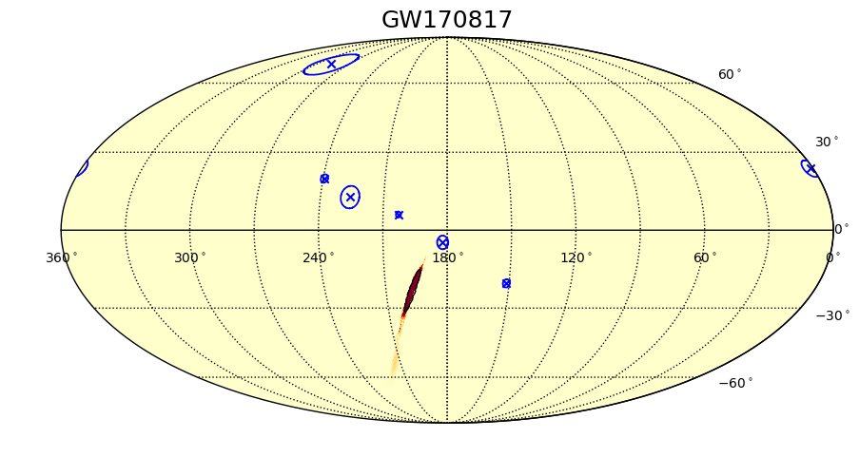
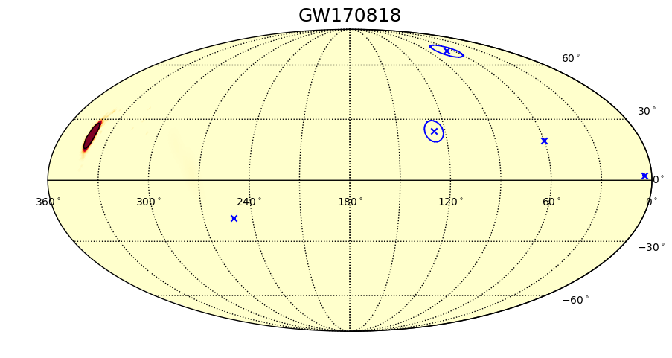
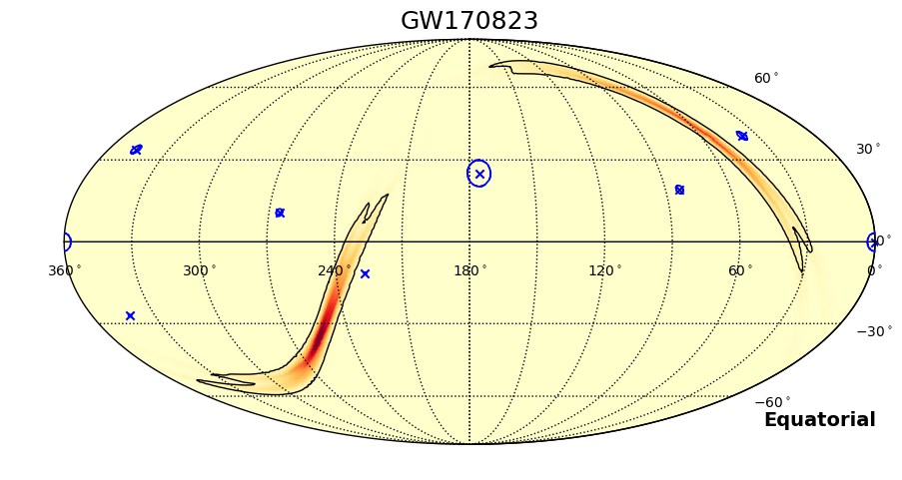
Simultaneous IceCube events: all 11 GW from O1 and O2
IceCube Collaboration,
arXiv:2004.02910
GW and IceCube event contours are 90% containment

Slide 7
Results: O1 and O2
No significant neutrino coincidence is found among the 11 GW in O1 and O2 GW (GWTC-1)
Results of maximum likelihood generic transients search
IceCube Collaboration, arXiv:2004.02910

Slide 8
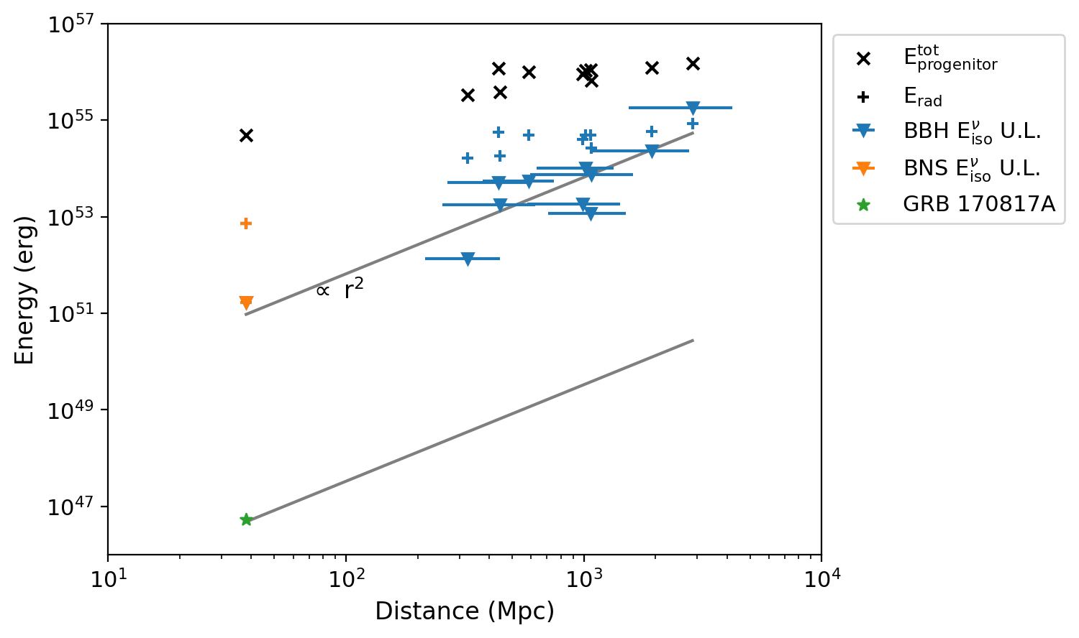
Results: O1 and O2
Given measured distance to source, set upper limits on bolometric energy in neutrinos (assuming isotropic emission)
Compare to energy scale radiated in GW
Compare to total rest mass energy in progenitor binary
Compare to gamma-ray energy in GRB 170817A (GW 170817)
IceCube Collaboration,
arXiv:2004.02910

Slide 9
Real-time analysis ran throughout O3
IceCube events are reconstructed and available in North within <1 minute
Analysis pipeline completes within a few minutes and identifies IceCube events in temporal (±500 sec) and spatial coincidence with GW
Results are human vetted and posted as GCN with coincident neutrino candidate information or upper limits, within few hours of GW detection
For coincident neutrino candidates, search region for counterparts is a few square degrees (~5 sq deg median) compared to a few hundred square degrees for full GW (~800 sq deg median)

Slide 10
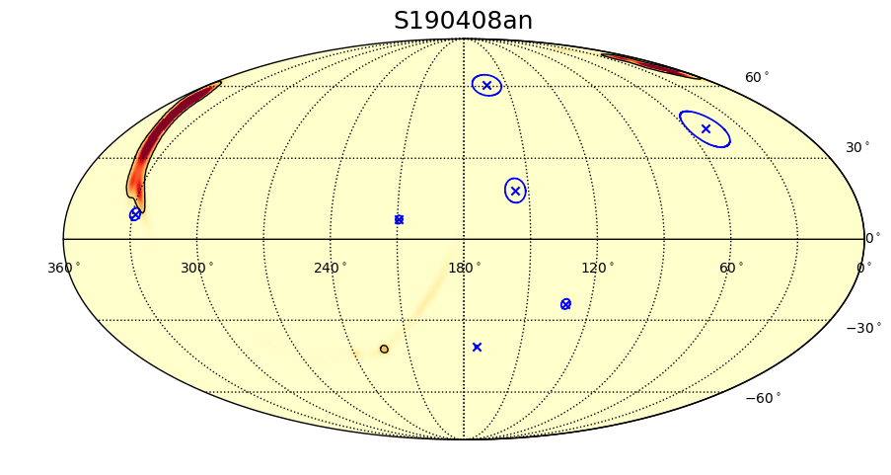
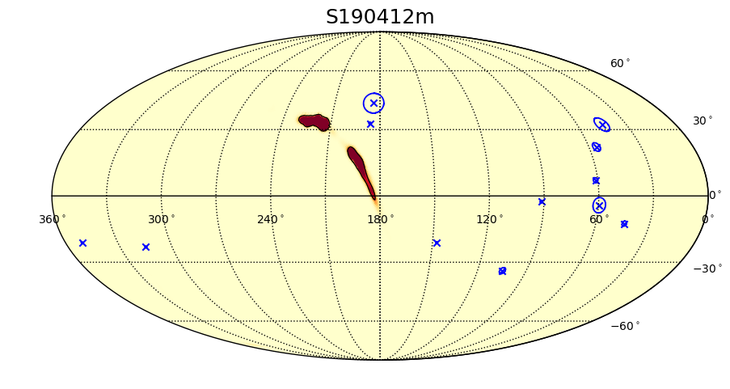
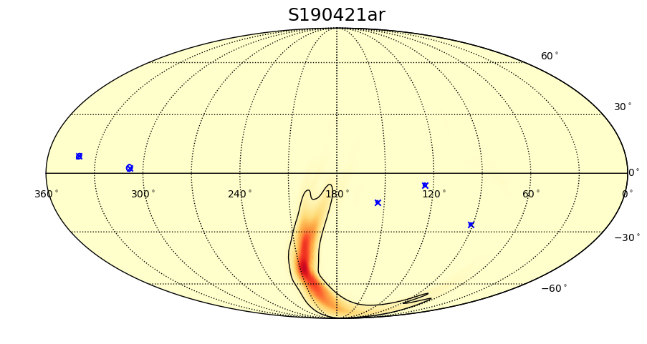
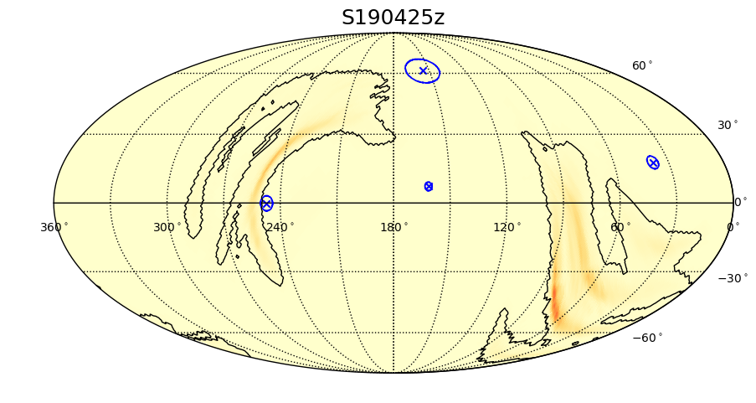
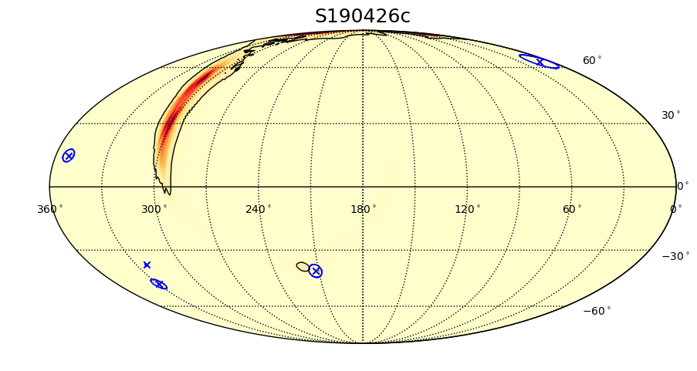
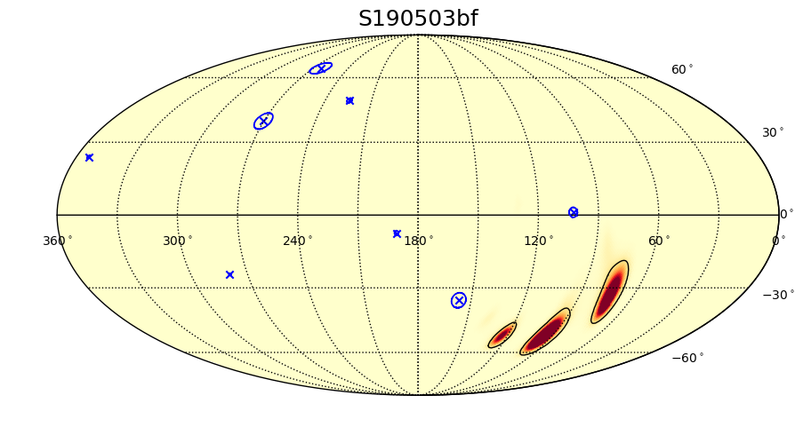
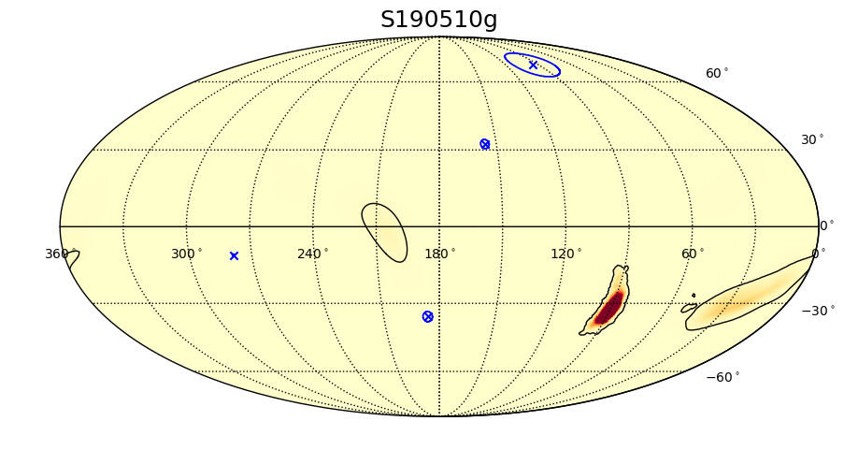
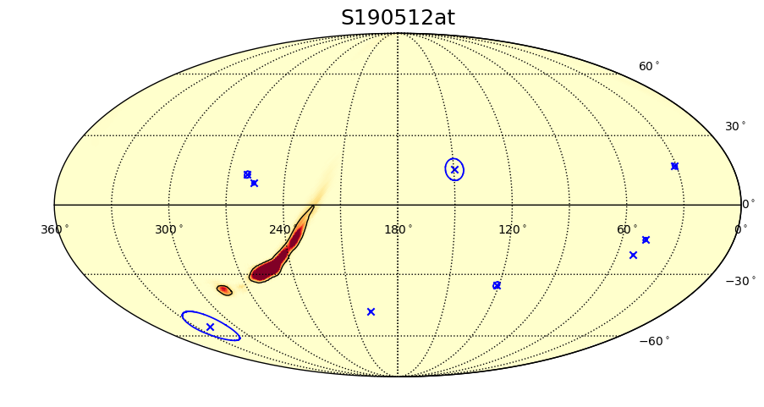
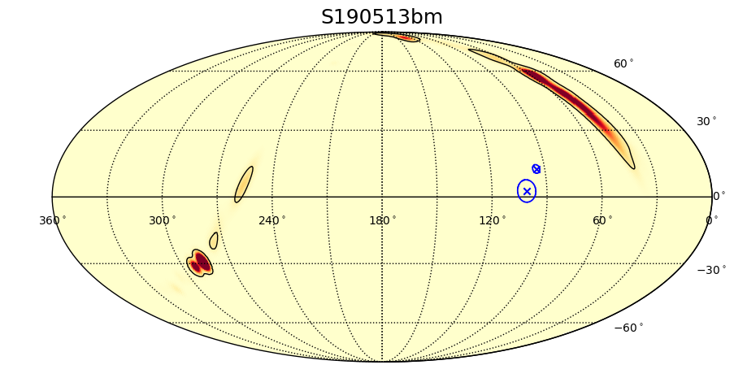
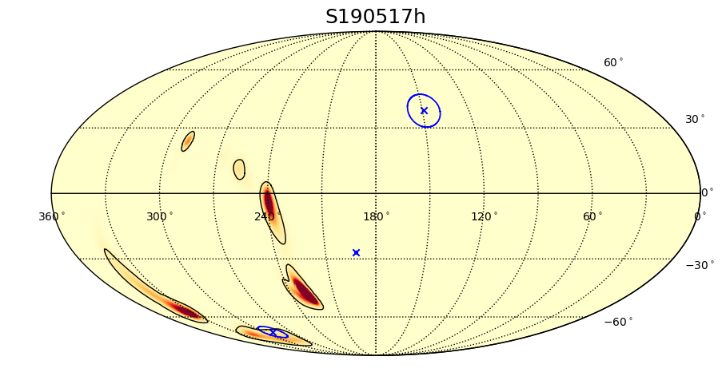
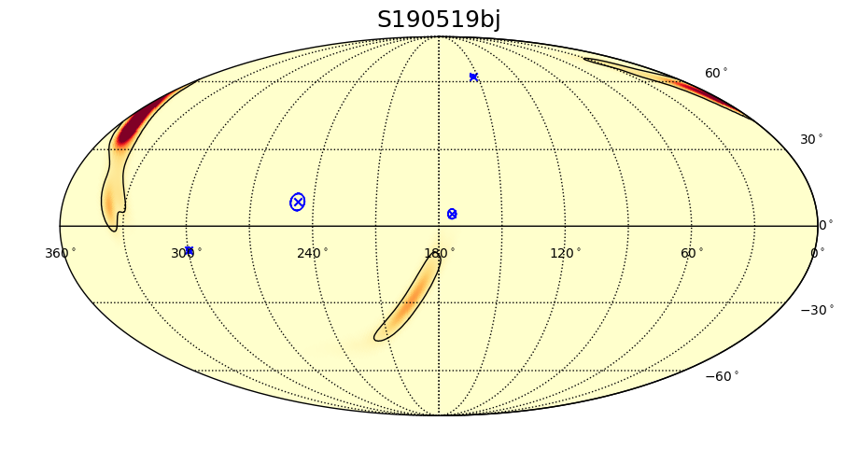
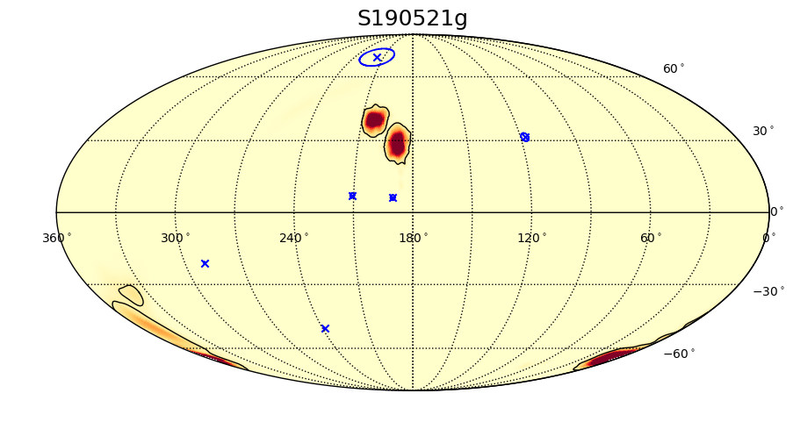
Simultaneous IceCube events: O3 (GW candidates 1–12)

Slide 11
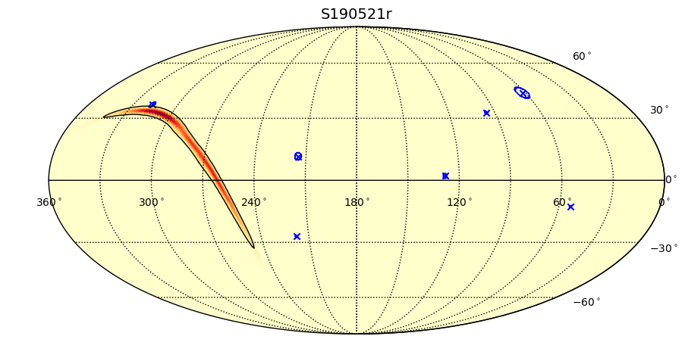
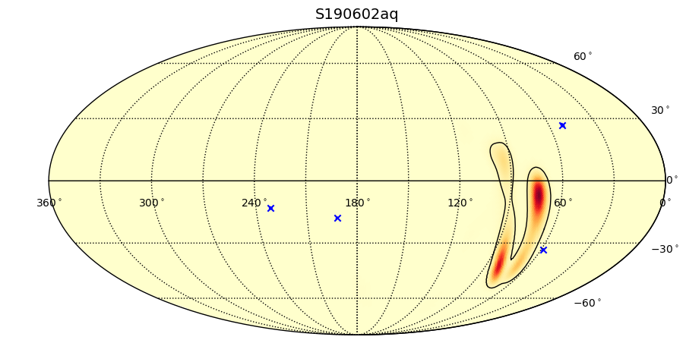
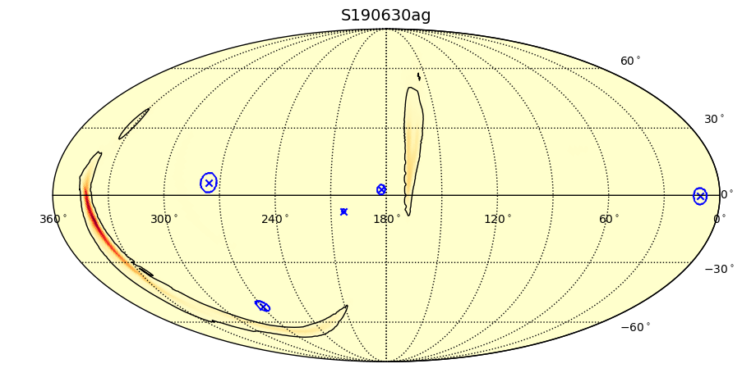
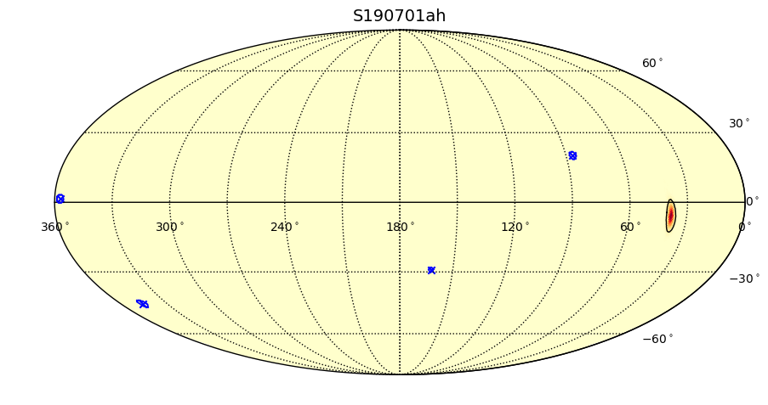
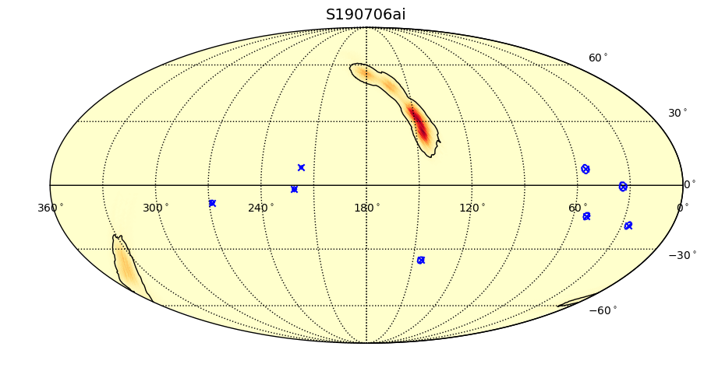
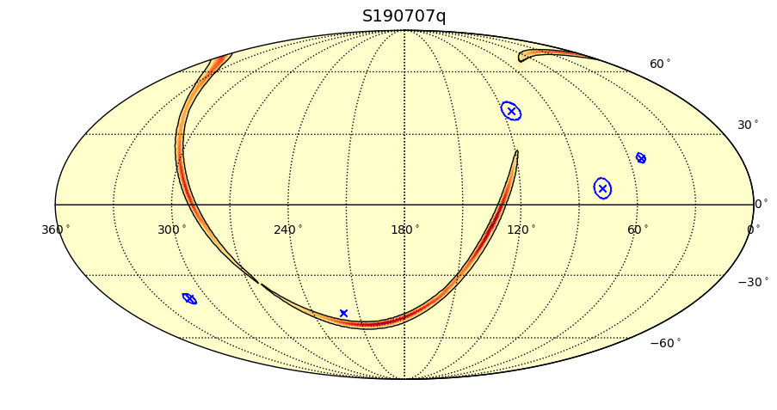
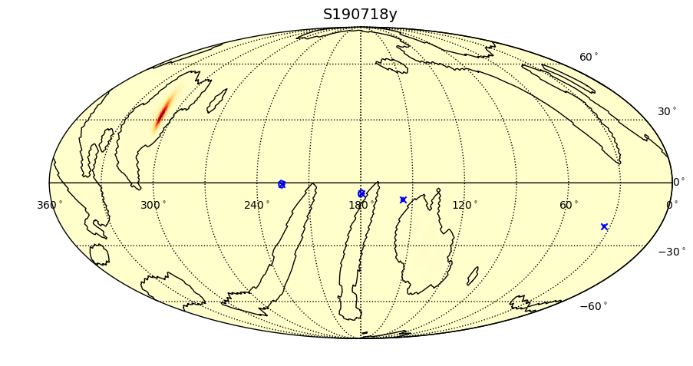
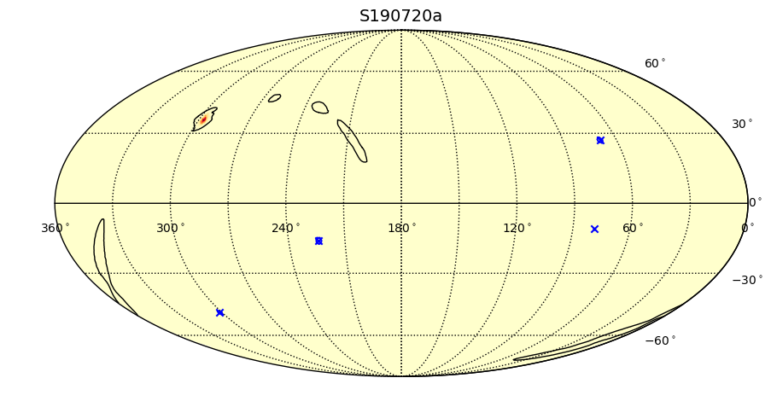
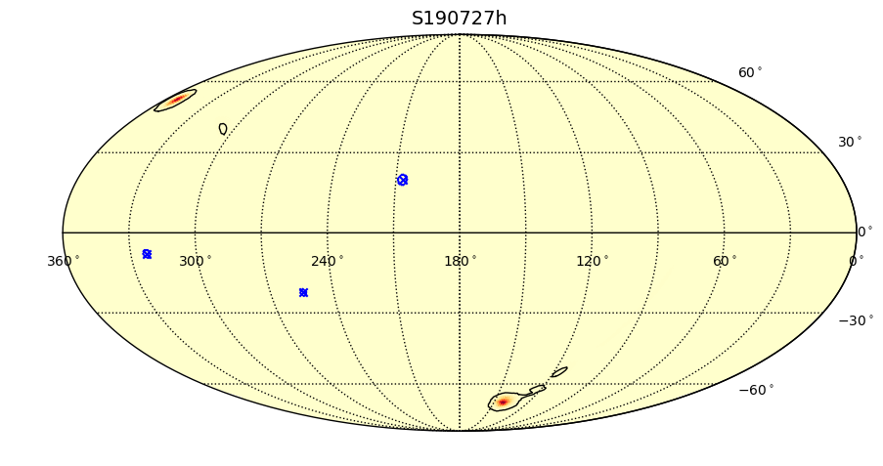
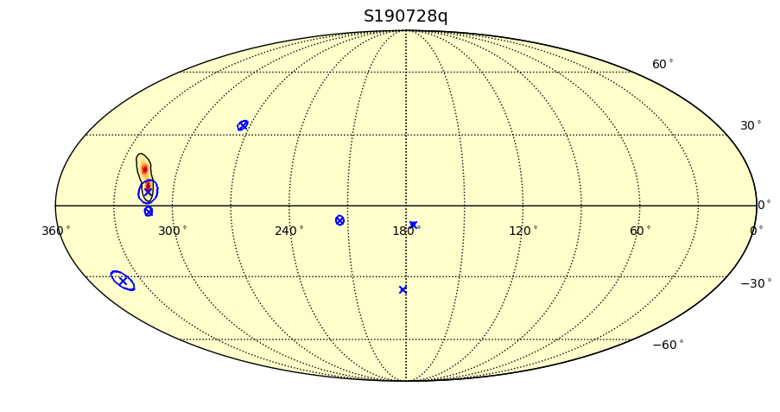
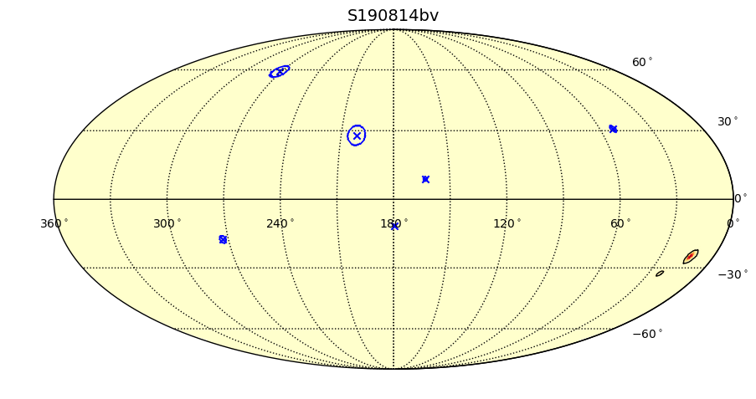
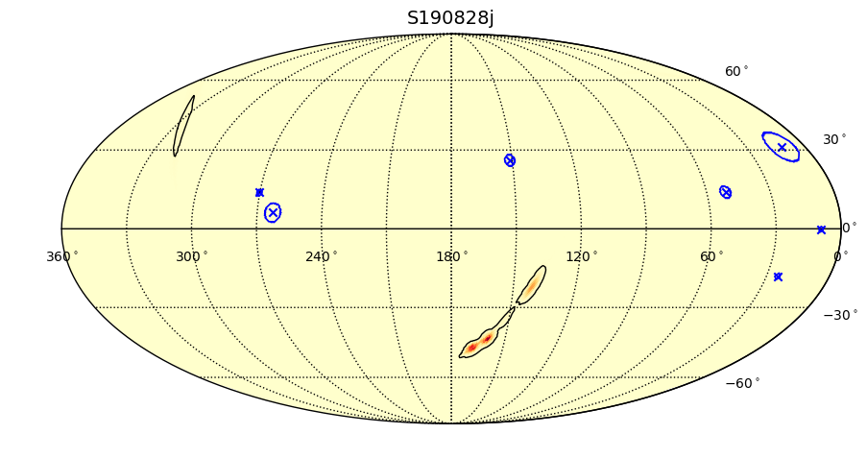
Simultaneous IceCube events: O3 (GW candidates 13–24)

Slide 12
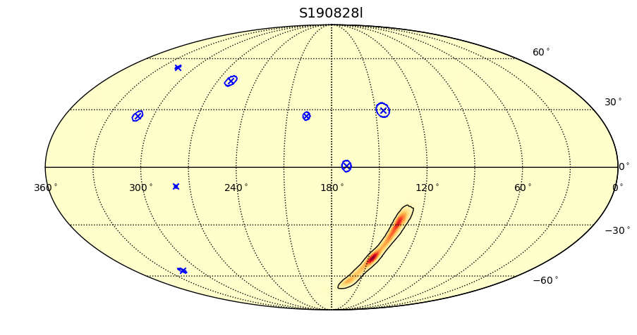
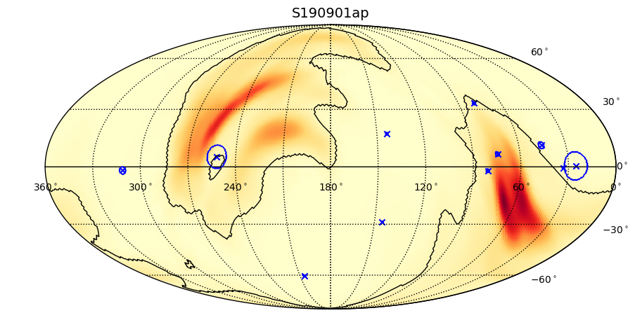
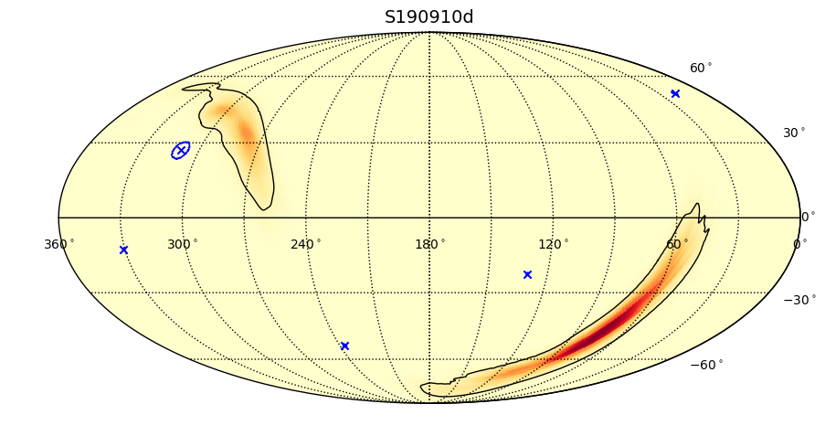
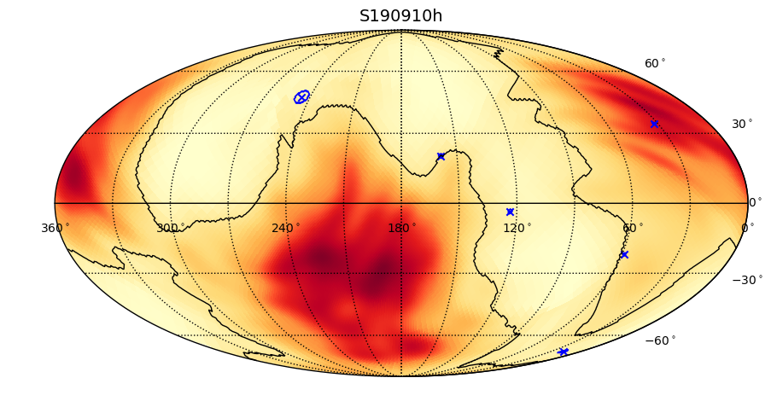
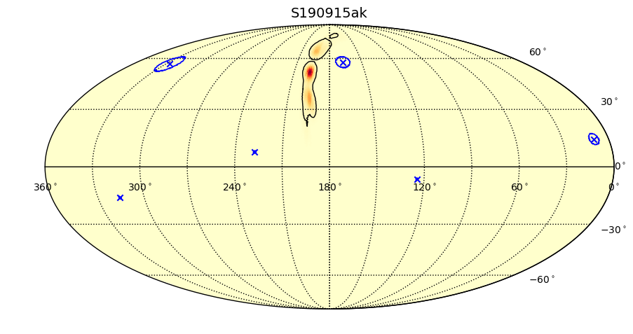
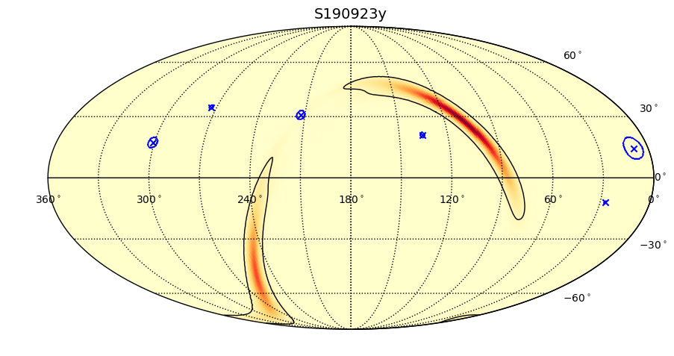
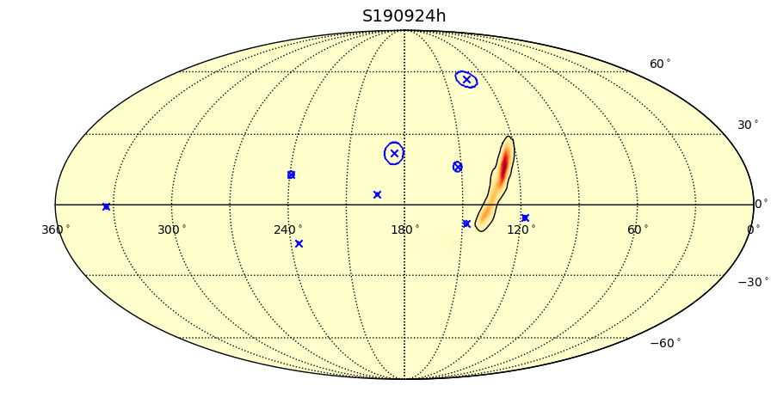





Simultaneous IceCube events: O3 (GW candidates 25-36)

Slide 13












Simultaneous IceCube events: O3 (GW candidates 37-48)

Slide 14








Simultaneous IceCube events: O3 (GW candidates 49-56)

Slide 15



Example GW–neutrino coincidence in O3
S190728q (BBH)
Coincident IceCube event reported publicly within few hours of GW
GCN: https://gcn.gsfc.nasa.gov/gcn3/25210.gcn3
$p$= 0.0136
IceCube Preliminary
IceCube Preliminary

Slide 16

P value distribution: all 67 O1, O2, O3 GW candidates
No evidence for neutrinos coincident with gravitational waves
Notes:
7+9+5+3+4+4+8+3+5+5+14 = 67
14+5+5+3+8+4+4+3+5+9+7 = 67

Slide 17

Results: O3 (first 28 candidates)
Neutrino U.L. min and max are constructed assuming point source hypothesis and varying location within 90% GW contour
Neutrino $E_{iso}$ U.L is computed by marginalizing over the 3D localization PDF for the GW source

Slide 18

Results: O3 (last 28 candidates)
Neutrino U.L. min and max are constructed assuming point source hypothesis and varying location within 90% GW contour
Neutrino $E_{iso}$ U.L is computed by marginalizing over the 3D localization PDF for the GW source

Slide 19

Results: O1, O2, and O3
Upper limit on isotropic-equivalent energy in neutrinos depends on source distance, declination distribution in localization sky map, and any coincident IceCube events
Energy is integrated from 10 GeV to 10^{9.5} GeV assuming E⁻² neutrino spectrum
1 of 67 has no distance estimate (cWB) so no E_{iso}
Notes:
Not yet all 67

Slide 20
Conclusion and outlook
Completed search for neutrinos coincident with all 67 GW candidates in O1, O2, and O3
No evidence for neutrino emission from gravitational wave sources
Some IceCube event coincidences with interesting statistical significance reported in real time, enabling rapid electromagnetic follow-up in a search region ~10² times smaller than GW localization
Results from O1 and O2 neutrino searches: IceCube Collaboration, arXiv:2004.02910
Real-time analysis pipeline responded to GW open public alerts in O3 with low latency, with IceCube GCNs reporting coincident neutrino events or upper limits posted within a few hours of GW detection
Additional searches planned for archival GW and future open public alerts
  Longer duration neutrino emission (two weeks)
  Neutrino-induced cascades, in addition to tracks

Slide 21
Backup slides

Slide 22
Analysis Procedure
Consider ±500 second time window
Perform all-sky scan over full sky
Weight resulting test statistic (TS) by spatial prior
Record maximum TS value in the sky
Perform 30k neutrino scrambles with fixed skymap
Event Sample:
Gamma-ray follow up (GFU) IceCube event sample
6.7mHz all sky rate
Median angular error <1° for neutrino energies >1TeV
Example: GW170608

Slide 23


Calculating the neutrino flux sensitivity
Compute 90% C.L. sensitivity flux, $E^{2}F$, by injecting neutrinos from Monte Carlo
Inject neutrinos until 90% of trials return a $Λ$ greater than the median of the background
For Upper Limits:
  For upper limits we use the observed $Λ$ as the threshold rather than the median
  If $Λ_{obs}<Λ_{median}$ then we use $Λ_{median}$as the threshold to be conservative

Slide 24


Likelihood Construction
Likelihood:
Test Statistic

Slide 25

Likelihood Construction
Likelihood:
$$S_{i}=\frac{1}{2πσ^{2}}e^{\frac{{Δψ}^{2}}{2σ^{2}}}ε(δ|γ)$$
$$B_{i}=\frac{1}{2π}B_{space}(δ) ε(δ)$$
Signal and Background
PDFs
Test Statistic

Slide 26


Likelihood Construction
Likelihood:
$$S_{i}=\frac{1}{2πσ^{2}}e^{\frac{{Δψ}^{2}}{2σ^{2}}}ε(δ|γ)$$
$$B_{i}=\frac{1}{2π}B_{space}(δ) ε(δ)$$
$n_{s}, n_{b}$: Expected number of signal and background events
Poisson Probability
Signal and Background
PDFs
Test Statistic
Free Parameters:
$n_{s}, γ$

Slide 27

Test statistic distribution (background only)
For every GW event we build a background test statistic ($Λ$) distribution using 30k neutrino scrambles and a fixed GW skymap

Slide 28
Interesting GW–neutrino coincidences
S190517h (BBH)
  one IceCube event (p=0.094 maximum likelihood)
  https://gcn.gsfc.nasa.gov/gcn/gcn3/24573.gcn3
S190728q (BBH)
  one IceCube event (p=0.014 maximum likelihood, p=0.010 Bayesian)
  https://gcn.gsfc.nasa.gov/gcn3/25210.gcn3
S191216ap (Mass Gap)
  one IceCube event (p=0.104 maximum likelihood, p=0.0059 Bayesian)
  https://gcn.gsfc.nasa.gov/gcn3/26460.gcn3
S200213t (BNS)
  one IceCube event (p=0.017 maximum likelihood, p=0.003 Bayesian)
  https://gcn.gsfc.nasa.gov/gcn3/27043.gcn3

Slide 29
Notes:
Figure from https://dcc.ligo.org/LIGO-G1901531/public

Slide 30

IceCube event localization area compared to GW
Notes:
All 67 GW candidates plotted
GFU is for actual GFU events (mostly background), scaled from estimated angular uncertainty (sigma)

